Slide 1
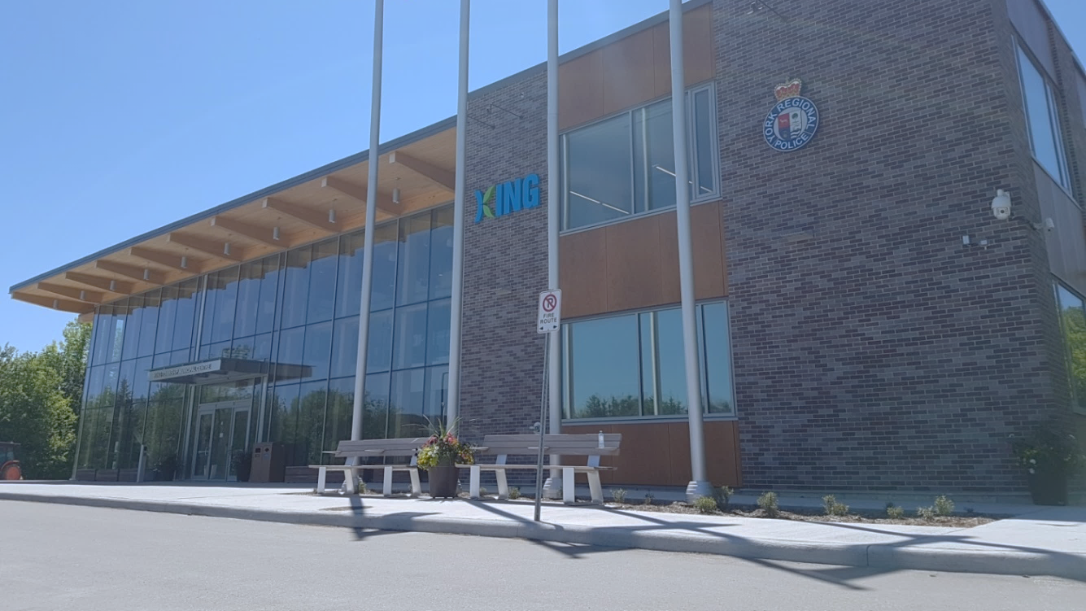

2023-2026 Corporate Strategic Plan Year 3 (2025) Annual Progress Report
Presented To: Township Council
Presented On: Monday April 13, 2026
Presented By: Alex Pinheiro, Strategic Policy Coordinator

Slide 2

Agenda
Governance Framework
Performance Accountability in King
Framework for Evaluating Strategic Progress: Objectives & Key Results
Strategic Performance Summary
Strategic Performance Highlights
Communications Plan
2025 CSP Progress Dashboard

Slide 3


Governance Framework
Community Vision & Mission
Corporate Mission, Vision & Values and Corporate Strategic Plan
.
Departmental Plans, Frameworks & Initiatives
Multi-Year Operational & Capital Planning
.
Council
Staff

Slide 4

Corporate Planning Frameworks and Performance Accountability
Term of Council
Corporate Strategic Plan / Service Budget
Daily
Employee Work Plans
Medium to Long Term
Official Plan, Master Plans and Frameworks
Annual
Budget & Business Plans
Strategic Performance
Objectives and Key Results (OKR)
Operational Service Performance
Results Based Accountability (RBA)

Slide 5

Framework for Measuring & Evaluating Strategic Performance

Slide 6

Objectives & Key Results (OKR)
Objective Key Results (OKR) Framework
Performance Measurement of Strategic Plans in Local Government
Accountability and Transparency of Strategic Performance
Qualitative & Quantitative Reporting
Reported Annually in Q2
Measure What Matters – John Doerr

Slide 7
Objectives & Key Results (OKR)
Priority AREAs defines the area of focus for strategic changes to be realized through implementation of the plan
Objectives What do we want to achieve?
KEY RESULTS THE RESULTS THAT TELL US IF WE HAVE ACHIEVED OUR OBJECTIVE
ACTIONS WHAT WE ARE DOING TO ACHIEVE OUR KEY RESULTS
DEVELOPING THE PLAN
REPORTING
ON THE PLAN
We will [objective] as measured by [key results]

Slide 8
Objectives & Key Results (OKR) - Example
Priority AREAs BE MORE ACTIVE
Objectives RUN THE SOUTHLAKE 5K
KEY RESULTS Run 2 KM a day for 2 months WALK 5 km a week for 2 months LIFT WEIGHTS 2X a WEEK for 2 months
ACTIONS Plan a 2km & 5km route CREATE A WEIGHT ROUTINE SET TRAINING ALARMS
DEVELOPING THE PLAN
REPORTING
ON THE PLAN
We will [objective] as measured by [key results]

Slide 9
Objectives & Key Results (OKR)
PRIORITY AREAS
THE TOP STRATEGIC PRIORITIES IDENTIFIED BY COUNCIL
A Greener Future
Sustainable Asset Management
Complete Communities
Service Excellence
OBJECTIVES
THE GOALS WE WANT TO ACHIEVE RELATED TO EACH PRIORITY
Mitigate Climate Change
Promote Tree Canopy Growth
Develop Asset Funding Strategies
Improve Capital Assets
Manage Growth to Best Serve King
Enrich Community Well-Being
Increase Data Driven Decision Making
Enhance Service Experience
A RESULT THAT
MEASURES THE
PROGRESS OF
EACH GOAL
KEY RESULTS
KR 1
KR 2
KR 3
KR 4
KR 1
KR 2
KR 3
KR 4
KR 1
KR 2
KR 3
KR 4
KR 1
KR 2
KR 3
KR 4
KR 1
KR 2
KR 3
KR 4
KR 1
KR 2
KR 3
KR 4
KR 1
KR 2
KR 3
KR 4
KR 1
KR 2
KR 3
KR 4
9

Slide 10
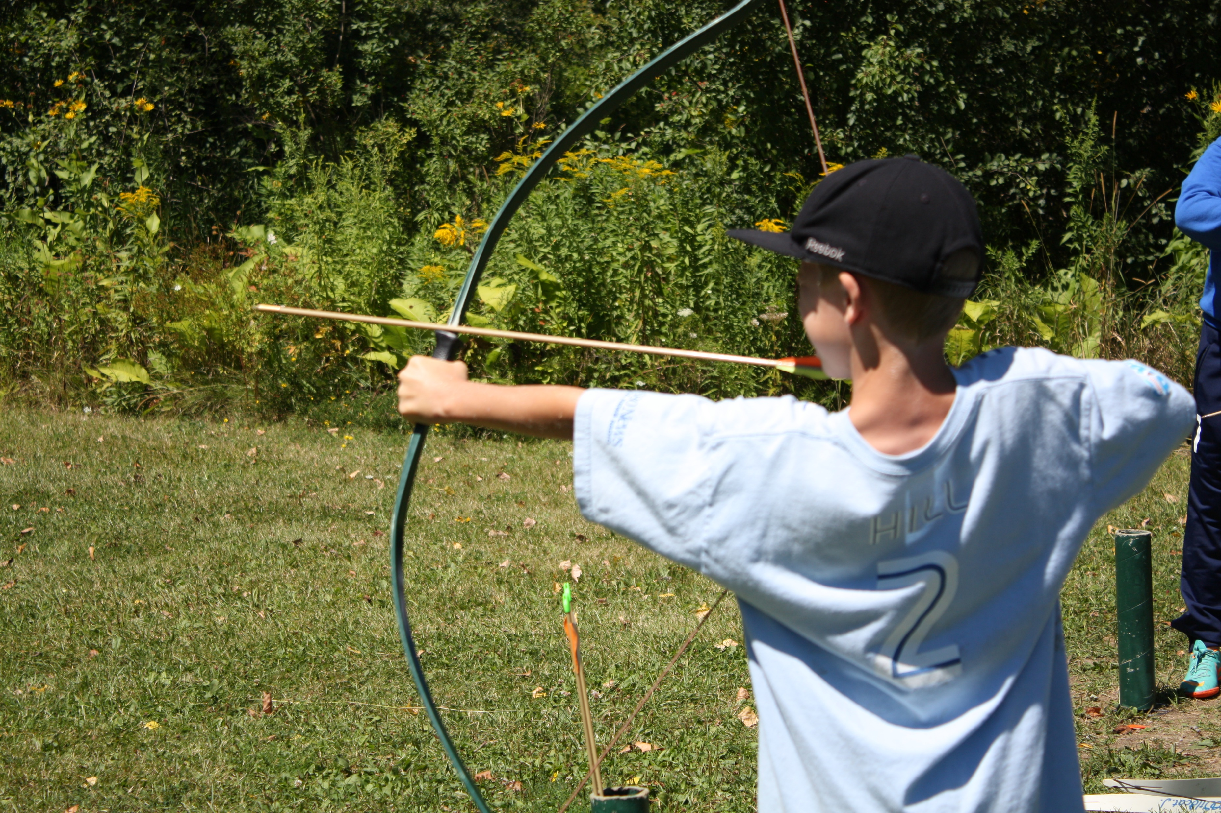
2025 Annual Progress Report

Slide 11
Strategic Performance Report Summary
29 Key Results
Percentage Towards Completion
Actions Undertaken
Status

Slide 12
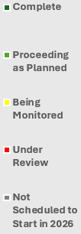
CSP Performance Report Summary
Legend
Key Results Status Summary
A Greener Future
Sustainable Asset Management
Complete Communities
Service Excellence

Slide 13
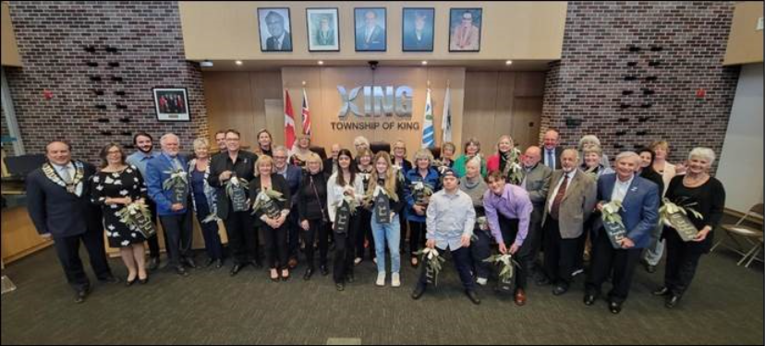
Highlights by Priority Area

Slide 14
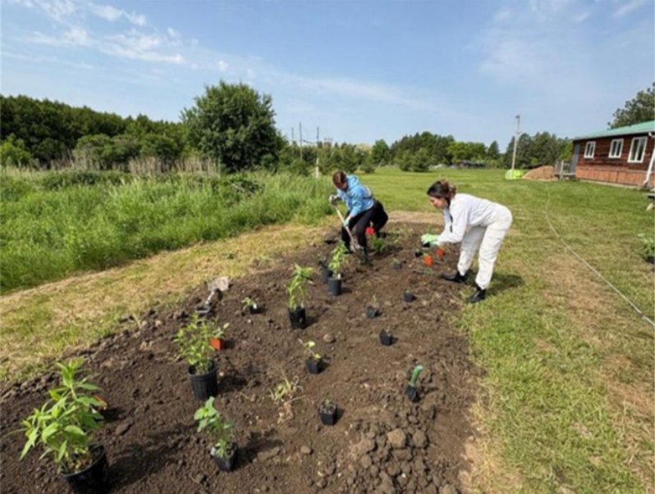
A GREENER FUTURE

Slide 15

Develop environmentally sustainable solutions to reduce King's footprint and mitigate against the impacts of climate change.
Adopt and Begin the Implementation of the Community Climate Change Action Plan 2026.
Reduce Corporate Emissions by 140 Tco2E (tonnes of carbon dioxide).
Develop a Green Development Standards Incentive Program by 2026.
100%
☑ Reviewed incentives driving the ThinKING Green Sustainable Development Program
☑ Completed a Jurisdictional Scan of Incentives in other Local Municipalities
☑ Received Council direction, defined non-financial incentive framework
☑ Advanced implementation of the King Community Climate Action Plan following Council endorsement
☑ Expanded the King Environmental Action Team and Foodcycler Program
☑ Supported opening of the Zancor Center, achieving the Zero Carbon Building Design Certification
☑ Launched a corporate composting program across municipal facilities
☑ Advanced corporate energy tracking and emissions analysis
PROCEEDING AS PLANNED
COMPLETED
PROCEEDING AS PLANNED

Slide 16

Promote Tree Canopy Growth and Enhance Natural Lands
Inventory all Township Natural Assets by 2026.
Develop an Invasive Species Management Strategy by 2026.
Achieve the York Region minimum canopy cover recommendation for King of 36%.
☑ Completed an Invasive Species Management Strategy for internal review
☑ Contributed to King’s Green Development Standards Program
☑ Managed 3,298m² of invasive species impacted areas in 2025
☑ Applied & Secured external Funding from Greenbelt Foundation
☑ Engaged an external consultant to advance Natural Asset Inventory
☑ Obtained and reviewed natural asset GIS datasets to inform deliverables
☑ Began implementation of the King Technical Forest Study
☑ Identified new restoration locations for plantings in 2026
☑ Leveraged grant funds to maximize planting activities
80%
20%
97%
3%
PROCEEDING AS PLANNED
PROCEEDING AS PLANNED
Plant 50,000 trees, shrubs and wildflowers.
☑ 13,831 plantings in 2025
☑ Engaged 736 volunteers over 1,183 hours to support planting activities
59%
PROCEEDING AS PLANNED
UNDER REVIEW
*40,000*

Slide 17
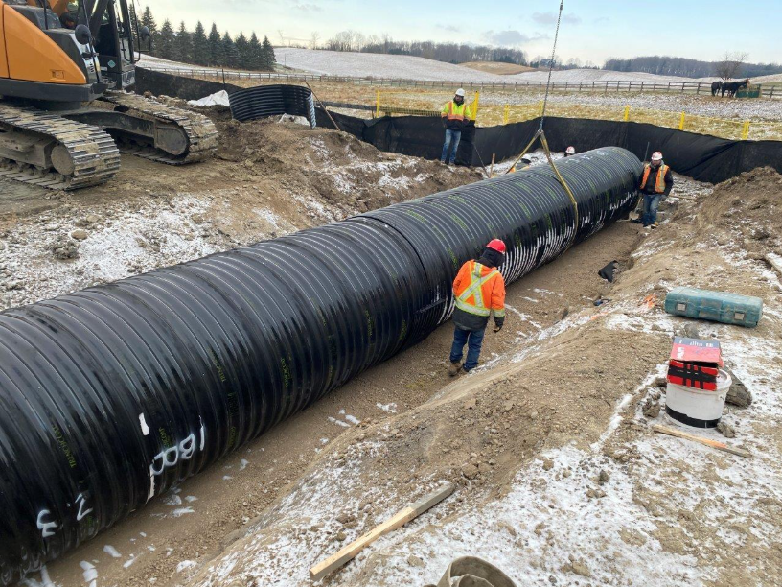
SUSTAINABLE ASSET MANAGEMENT

Slide 18
Develop asset funding strategies which ensure long term fiscal sustainability.
Implement a Stormwater Charge by 2023.
Finalize and Implement the Asset Management Program by 2025.
☑ Key Result completed in 2023 reporting year
☑ Completed Phase 2 of the core Asset Management Program
☑ Incorporated the following into a Comprehensive Asset Management Plan:
Phase 1 (non-core assets) & Phase 2 (core-assets)
Asset Management Funding Strategy
Capital Asset Levels of Service
COMPLETE
Create and Implement an Asset-Funding strategy by 2025.
☑ Reviewed financial assumptions associated with proposed service levels to assess long-term affordability
☑ Finalized the Asset-Funding Strategy as part of the 2025 Comprehensive Asset Management Plan
100%
100%
COMPLETE
COMPLETE

Slide 19
Improve our capital assets (transportation, environmental, facilities and parks) for continued community use and enjoyment.
Develop and Implement a Stormwater Monitoring and Maintenance Strategy by 2026.
Update (5) asset-related Master Plans & Strategies by 2025.
☑ Developed the Stormwater Operations and Maintenance Manual to define Township standards
☑ Started pond clean-outs using risk-based prioritization metrics
☑ Strengthened internal capacity through training and a new Environmental Technologist
PROCEEDING AS PLANNED
Establish the levels of service for all capital assets by 2025.
Develop an Asset Disposition Strategy by 2025.

Slide 20
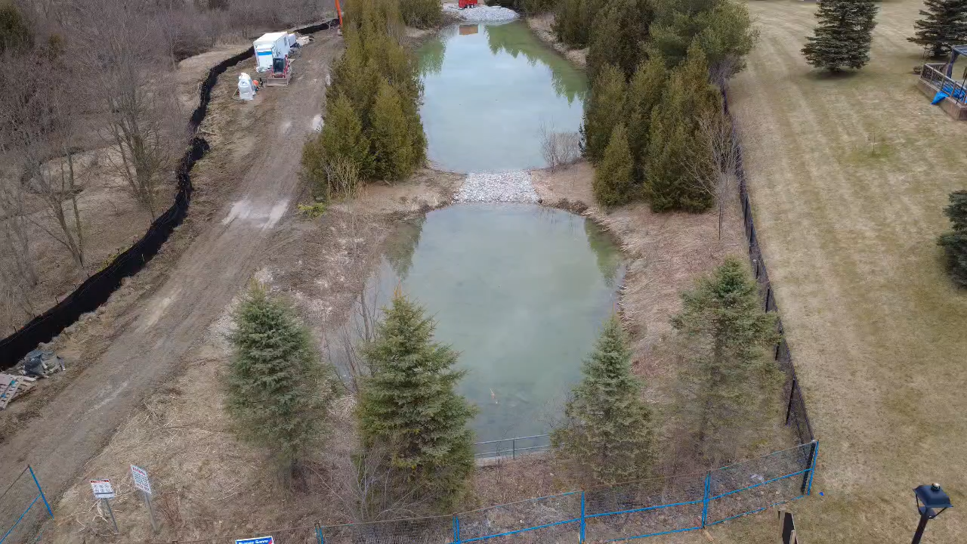
Fall 2025 Pond Clean-Out

Slide 21
Improve our capital assets (transportation, environmental, facilities and parks) for continued community use and enjoyment.
Develop and Implement a Stormwater Monitoring and Maintenance Strategy by 2026.
Update (5) asset-related Master Plans & Strategies by 2025.
☑ Developed the Stormwater Operations and Maintenance Manual to define Township standards
☑ Started pond clean-outs using risk-based prioritization metrics
☑ Strengthened internal capacity through training and a new Environmental Technologist
PROCEEDING AS PLANNED
Completed technical review and engagement to support finalizing the following plans:
☑ Parks & Trails Master Plan
☑ Facilities Master Plan
□ Transportation Master Plan (TMP)
□ Active Transportation Strategy (ATS)
□ Water/Wastewater Master Plan (WWWMP)
Establish the levels of service for all capital assets by 2025.
Develop an Asset Disposition Strategy by 2025.
☑ Finalized the Levels of Service as part of the 2025 Comprehensive Asset Management Plan
☑ Completed GIS-based mapping layer of municipal assets
COMPLETE
UNDER REVIEW
PROCEEDING AS PLANNED

Slide 22
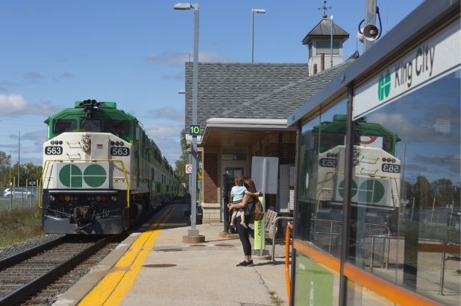
COMPLETE COMMUNITIES

Slide 23
Implement regulatory changes to manage growth which best serves King’s unique landscape.
Complete the Official Plan review and update (to 2051) by 2025 2027.
Update Urban Zoning By-law within 1 year of the OP update.
Explore opportunities for Commercial Licensing and if approved, implement programs by 2026.
SCHEDULED TO START IN 2027
☑ Completed the Growth Management and Employment Lands Strategies
☑ Started work on Natural Heritage Background Report
☑ Integrated Neighbourhood Plan into Official Plan Review
NOT STARTED
☑ Gathered community input from in-person open house and online public survey
☑ Engaged external stakeholders to inform policy decisions
☑ Developed Commercial Licensing Framework Discussion Paper
Conduct the Blue Box Transition by 2025.
☑ Completed transition to provincially-led program
☑ Communicated service changes, gathered feedback, and advocated for residents.
PROCEEDING AS PLANNED
COMPLETE
PROCEEDING AS PLANNED

Slide 24
Enrich community well-being and make King the ideal place to live, work and play.
Develop and implement a streamlined program that consolidates all existing municipal funding, grant programs, donations, and in-kind contribution requests by 2024.
Develop an Action Plan and begin implementation to become an “Age-Friendly Community” by 2026.
Represent King’s interest in major external developments within the Township.
☑ Monitored and advocated for King in the development of:
Zoning enforcement and illegal land use policies
Expanded rural eligibility for Building Faster Fund
Climate-resilient infrastructure investments in agricultural areas
☑ Engaged 51 businesses exploring investment in King
☑ Completed Age-Friendly Action Plan
☑ Key result completed in 2024 reporting year
PROCEEDING AS PLANNED
Develop and implement an annual Traffic-Safety campaign that runs for (1) month annually.
☑ Created the “Safe Streets Campaign” and Launched the Campaign for 4 weeks
☑ Collaborated with York Region Police
☑ Began plan for 2026 annual campaign
100%
COMPLETE
PROCEEDING AS PLANNED
PROCEEDING AS PLANNED

Slide 25

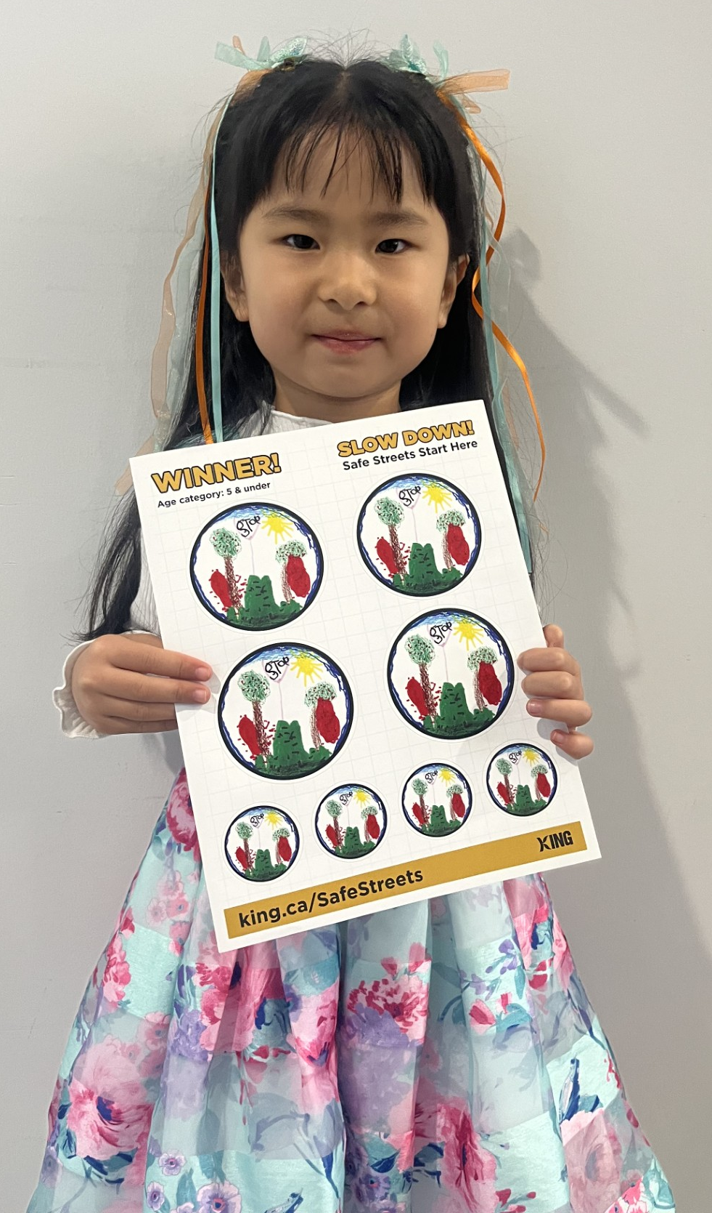
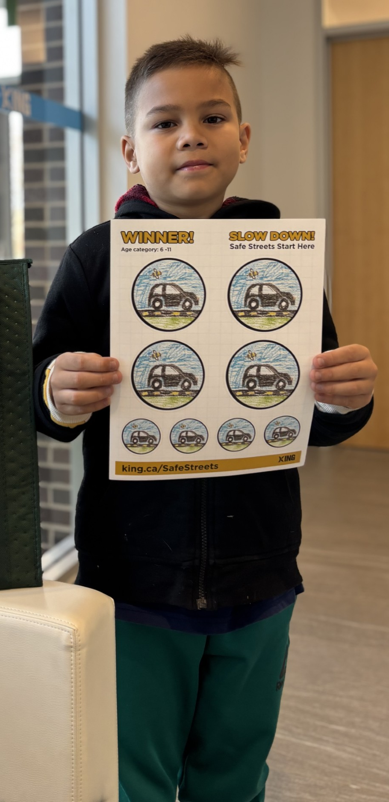
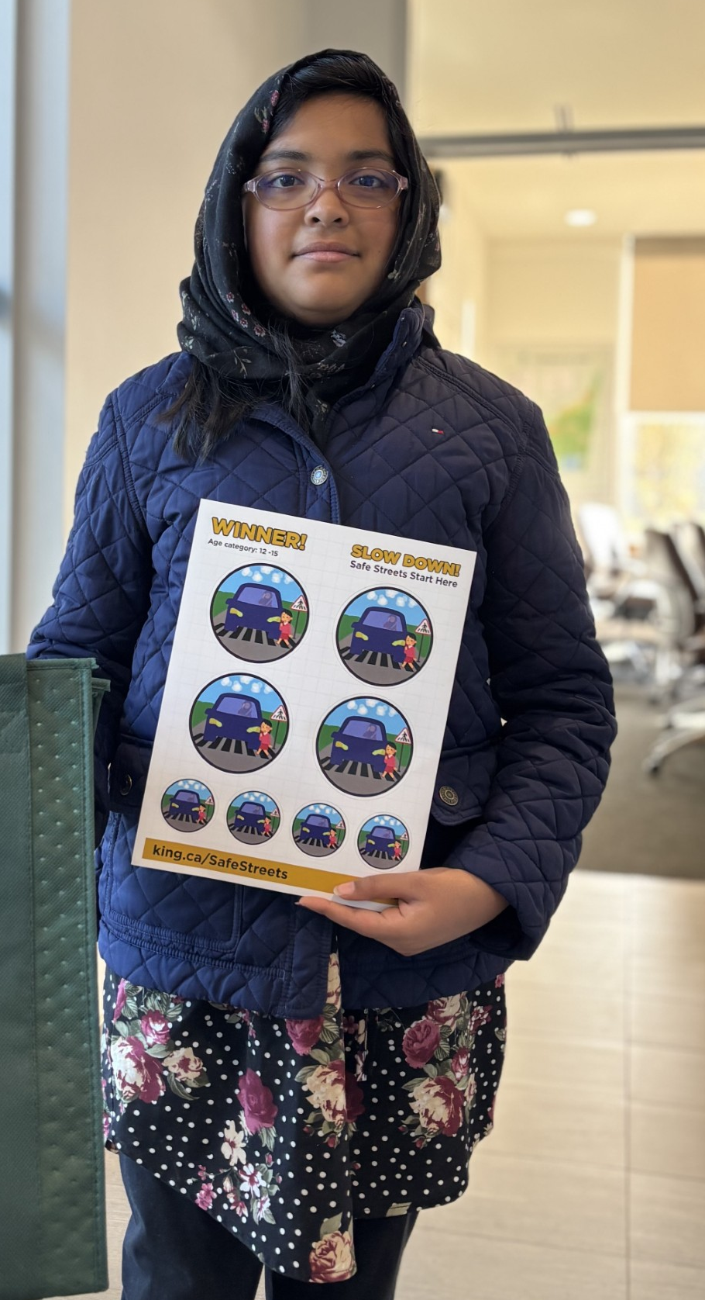
2025 Youth Sticker Design Contest

Slide 26
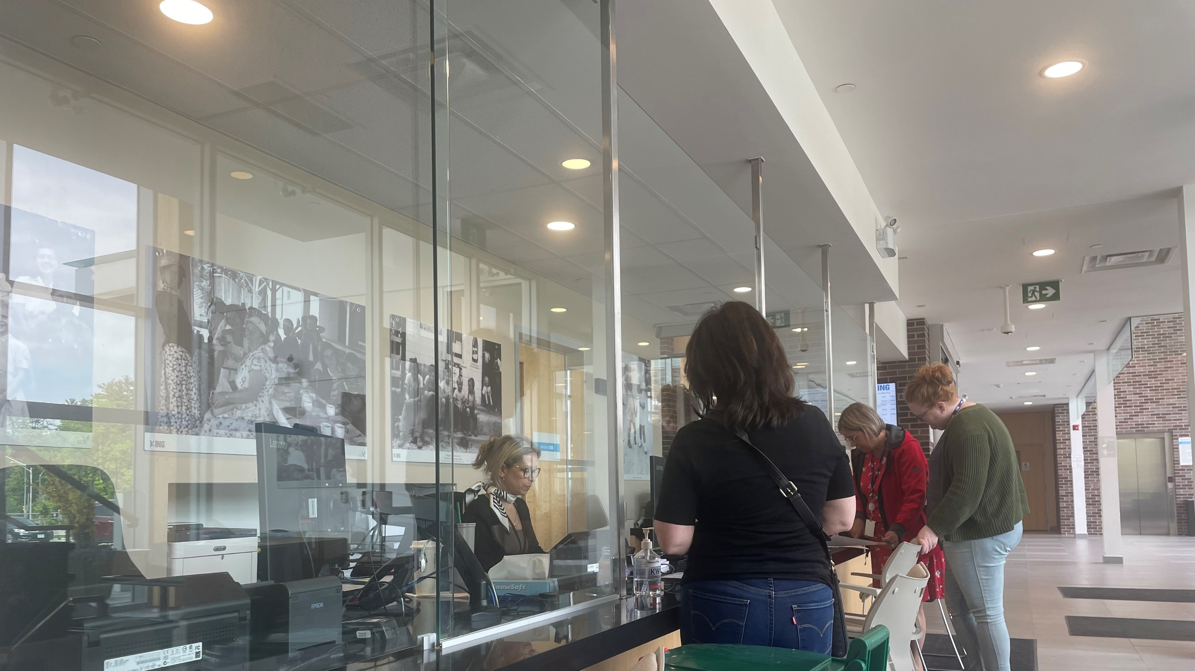
SERVICE EXCELLENCE

Slide 27

Increase data-driven decision making to improve organizational performance
Develop and evolve a Corporate Performance Accountability Program by 2026.
Develop a Digital Transformation Framework and implement Phase 1 by 2025.
☑ Developed and launched the Digital Transformation Framework
☑ Finalized Cyber Security and Risk Management Playbook
☑ Finalized the Data Masterplan
☑ Retained a consultant to validate engagement and develop a forward digital roadmap
☑ Developed Corporate Performance Accountability Program Administrative Policy
☑ Launched Divisional Service Profiles
☑ Developed Strategic Performance Reporting Procedures
☑ Developed Operational Performance Reporting Procedures
COMPLETE
Publish (4) new open-data sets.
75%
25%
☑ Key result completed in 2024 reporting year
PROCEEDING AS PLANNED
COMPLETE

Slide 28
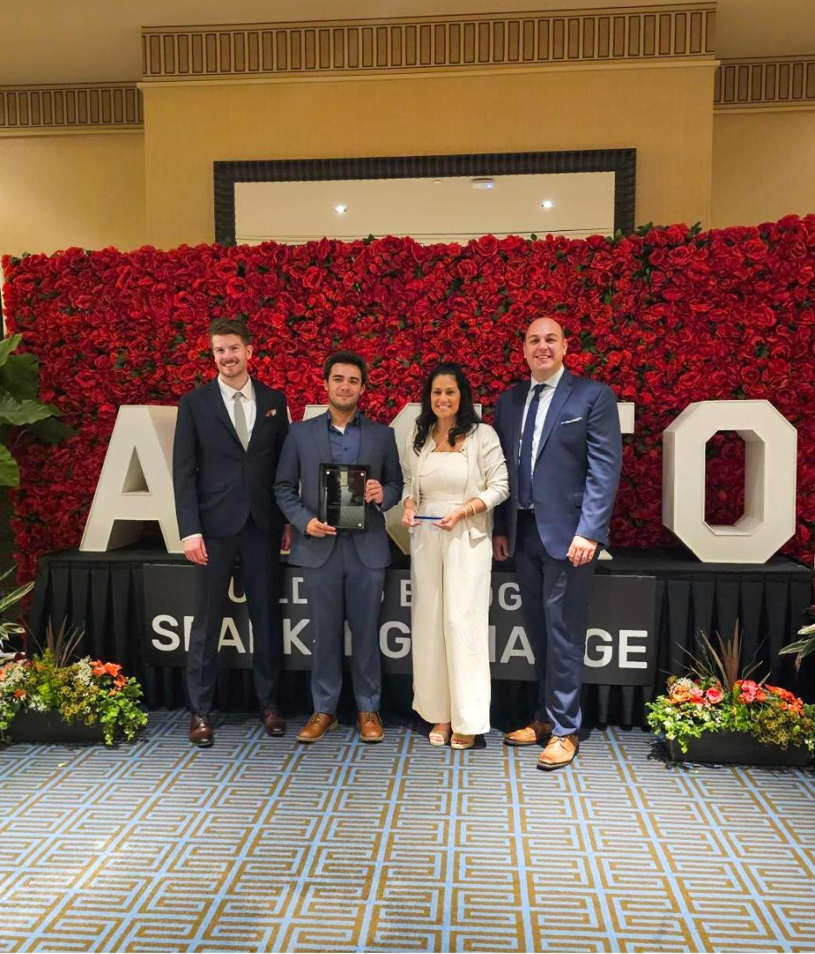
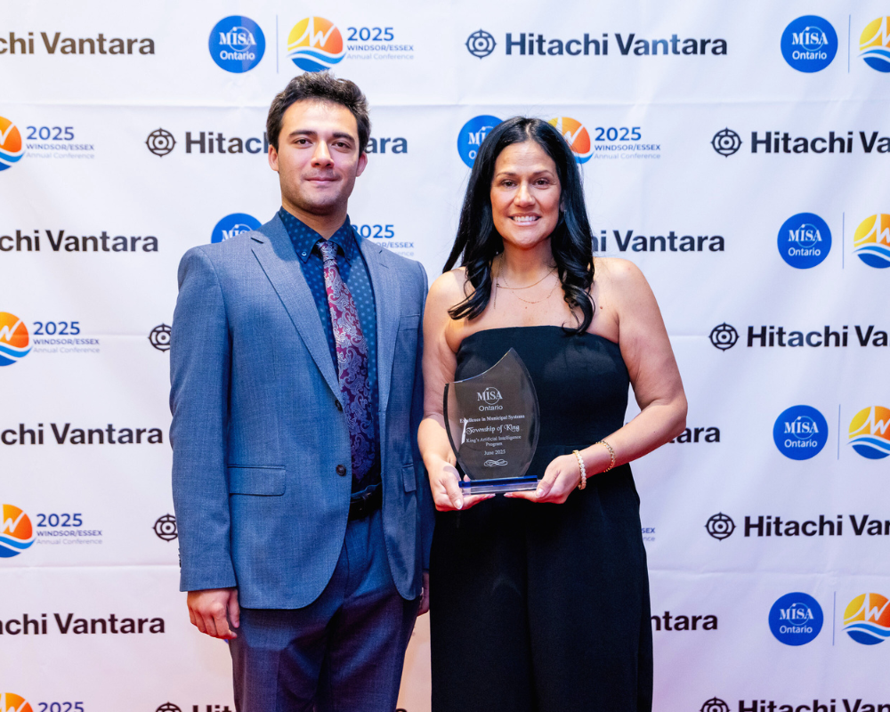
2025 Artificial Intelligence Program Recognition
MISA’s Excellence in Municipal Systems Award
AMTCO’s E. A. Danby Award

Slide 29
Enhance service experience.
Develop and implement a Customer Experience Strategy by 2025.
Launch (2) new ServiceKING locations for expanded community use and access.
Reduce “Information Only” Cases by 30%.
☑ Developed Customer Experience Action Plan & Road Map
☑ Received Council endorsement for Customer Experience Strategy
☑ Published ads, posts and reels based on weekly top 3 ServiceKING inquiries
☑ Executed over 100 communications campaigns
☑ Launched appointments through AskKing Zoning Service
☑ Expanded Kingsley knowledge base using York Region service data
COMPLETE
90% of all Township application, requests and forms can be submitted in an automated form.
☑ Launched two new ServiceKING locations, offering services such as:
Tele-support for ServiceKING and recreation inquiries
In-person service bookings
Sale of garbage tags
☑ Key result completed in 2024 reporting year
COMPLETE
COMPLETE
PROCEEDING AS PLANNED

Slide 30
CSP Performance Report Summary
Legend
Key Results Status Summary
A Greener Future
Sustainable Asset Management
Complete Communities
Service Excellence

Slide 31
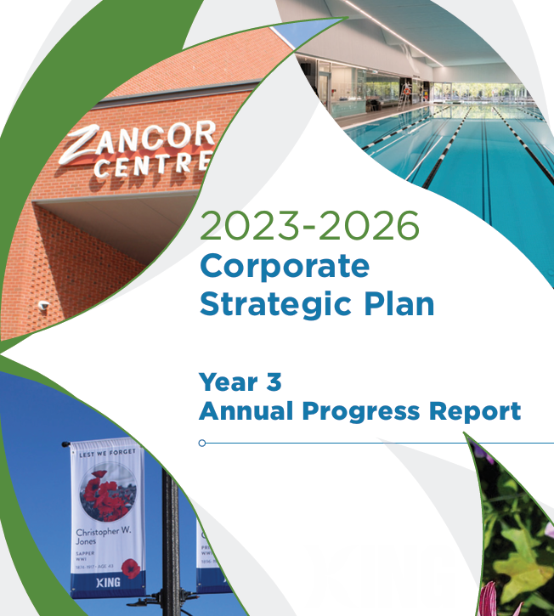
Communications Plan
Newspaper Half Page Ad
Social Media
Media Release
King.ca

Slide 32


2025 (Year 3) Annual Progress Report Strategic Plan Dashboard

Slide 33
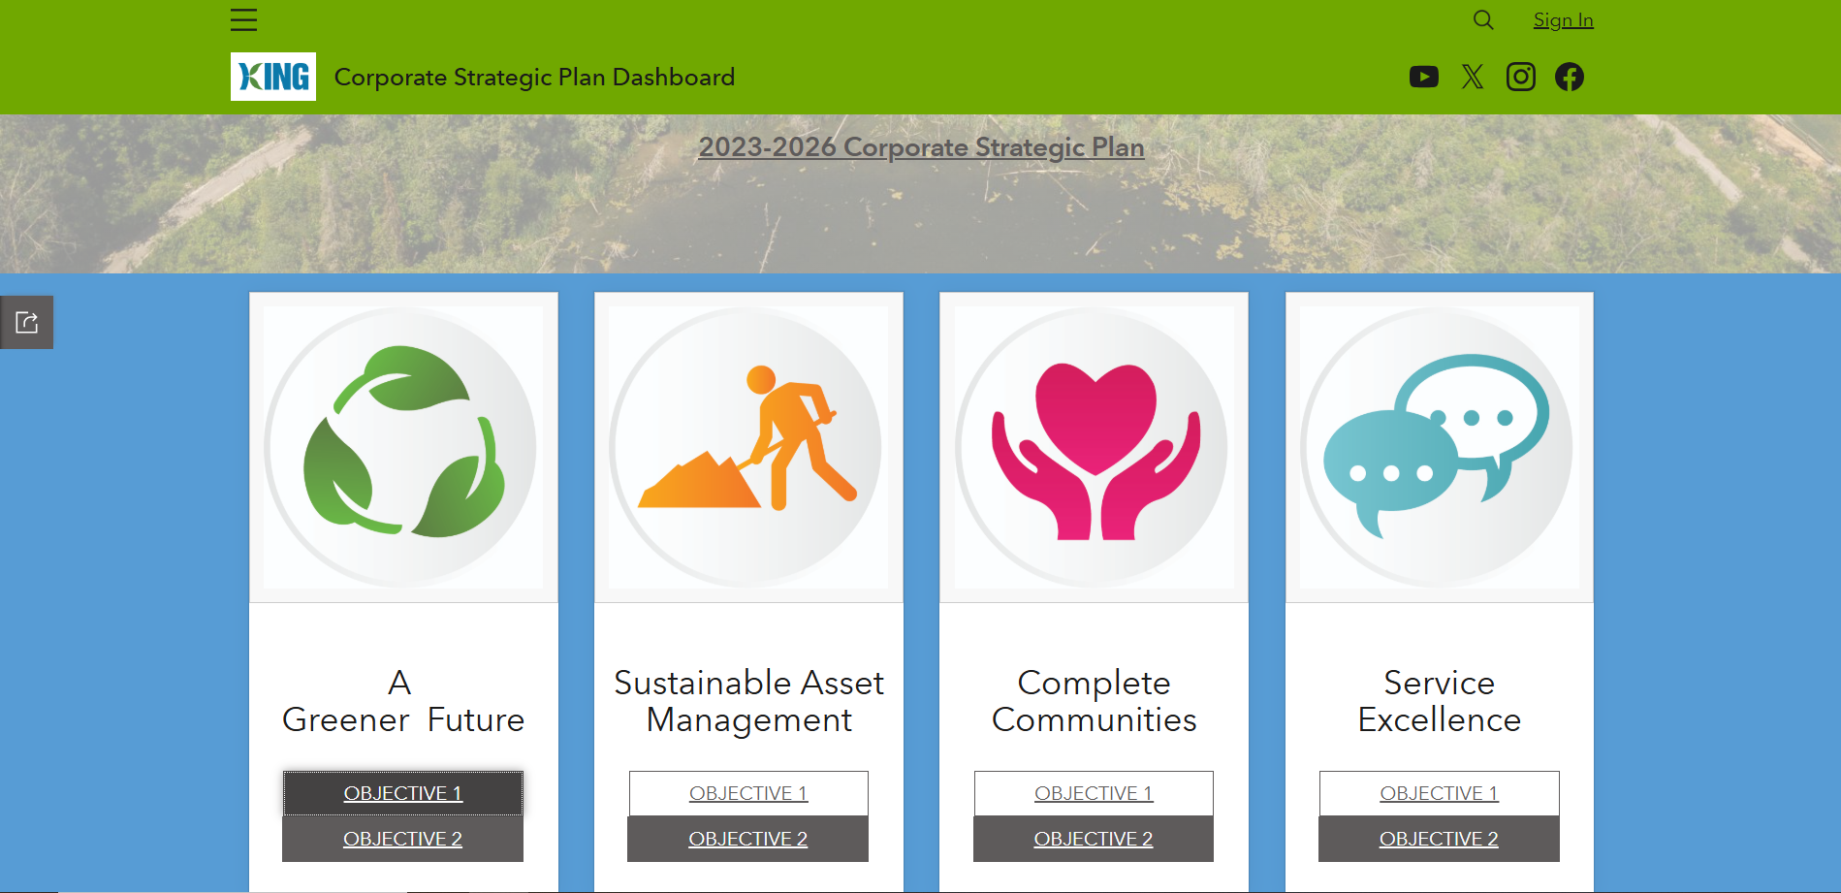
Strategic Plan Dashboard

Slide 34
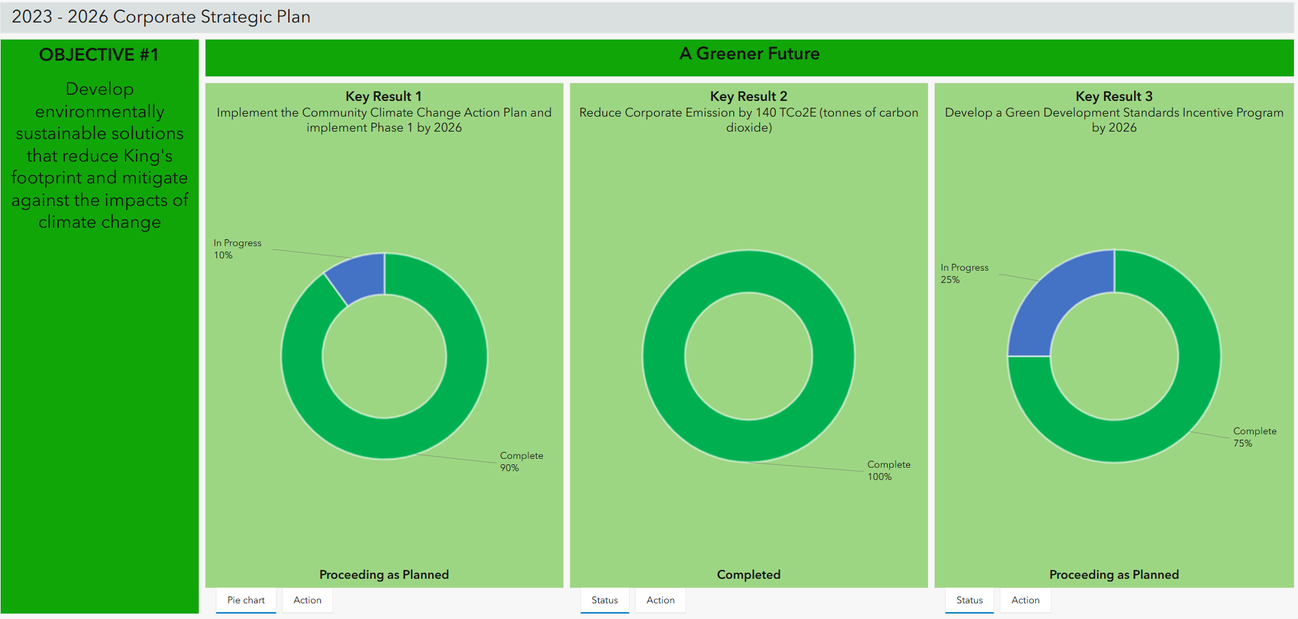
Strategic Plan Dashboard

Slide 35
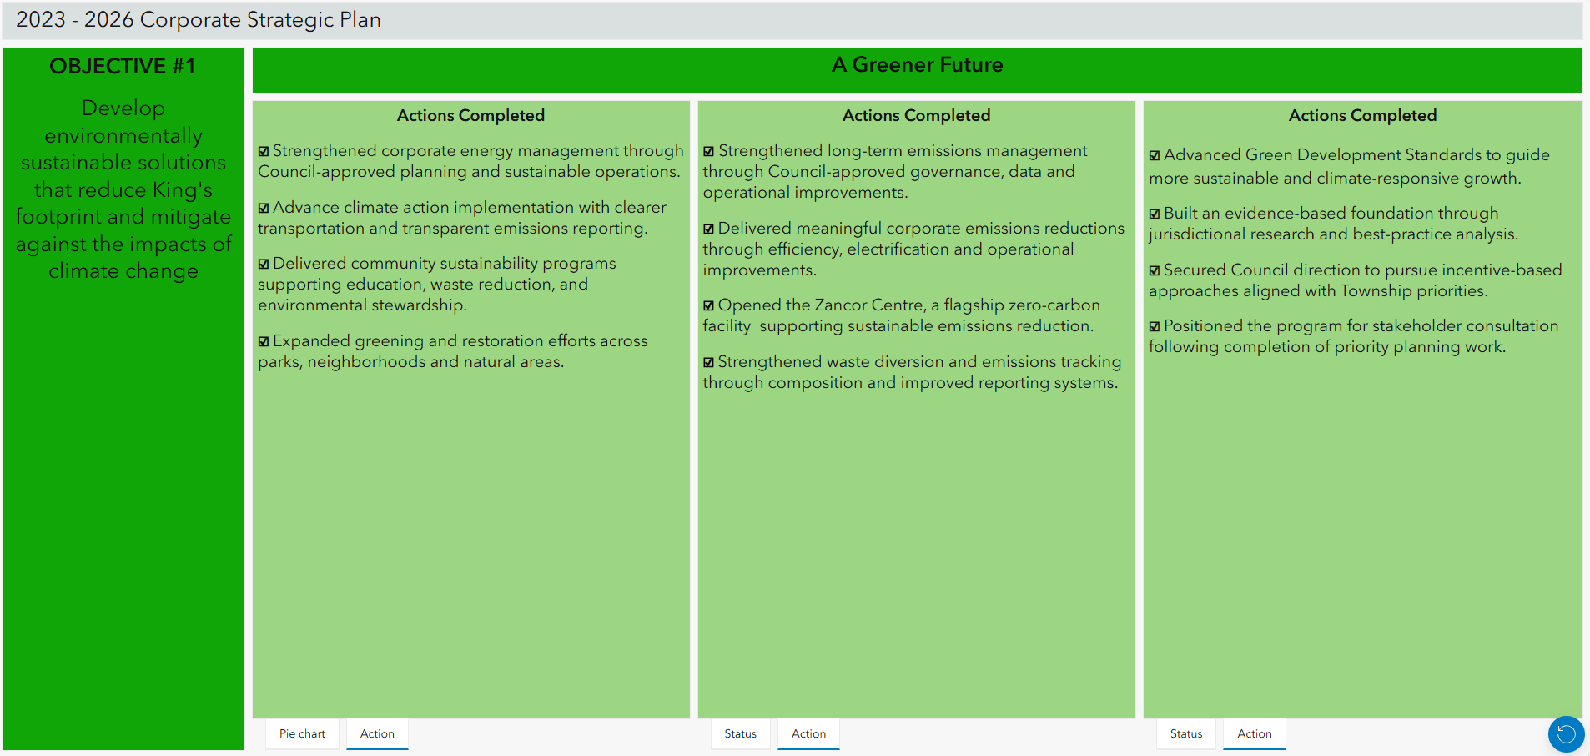
Strategic Plan Dashboard

Slide 36
Concluding Remarks

Slide 37
COUNCIL Q&A

