Slide 1
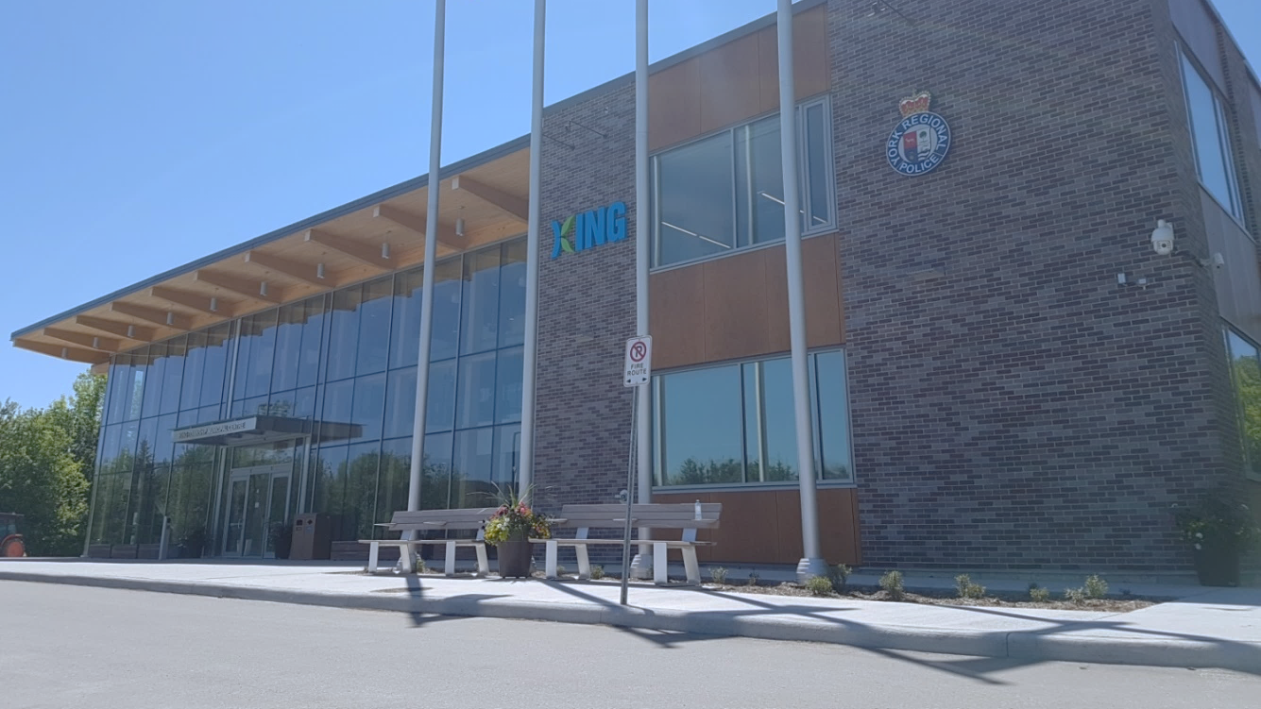
2023-2026 Corporate Strategic Plan Year 2 (2024) Annual Progress Report
Presented To: Township Council
Presented On: Tuesday April 29, 2025
Presented By: Cara Santoro, Supervisor of Strategy & Transformation (A)
Notes:
Thank you, Daniel for the opening remarks and thank you Mr. Mayor and all members of Council for receiving this presentation today on the Year 2 annual progress report for the corporate strategic plan.
*PAUSE THE PPT*
*CLICK

Slide 2
Agenda
Governance Framework
Performance Accountability in King
Framework for Evaluating Strategic Progress: Objectives & Key Results
Strategic Performance Summary
Strategic Performance Highlights
Communications Plan
2024 CSP Progress Dashboard
Notes:
For today’s presentation, I would like to briefly review our governance framework with you and provide a very quick refresher on how King remains accountable to strategic performance.​
​
Following this, I will provide Council with an overall strategic performance summary for the 2024 reporting year as well as performance highlights from each of our 4 individual priority areas. It is important to note that these highlights will convey actions from the 2024 reporting year only and will not convey any actions completed from January until present as those actions would be detailed in the 2025 report.
​
I will then finish this presentation with a summary of our communications plan so that we get the story of our year 2 strategic progress out to as many residents as possible.
*CLICK

Slide 3
Governance Framework
Community Vision & Mission
Corporate Mission, Vision & Values and Corporate Strategic Plan
.
Departmental Plans, Frameworks & Initiatives
Multi-Year Operational & Capital Planning
.
Council
Staff
Notes:
The pyramid you see here provides a visualization of the Township's governance framework.​
This framework shows how King sets directions, plans for and makes decisions that guide us into our desired future.
As you can see, the pyramid illustrates Council’s role in setting the long-term vision for the Township, informed by residents, which trickles down through leadership and then staff work to make councils desired future for King real.​
*CLICK

Slide 4
Corporate Planning Frameworks and Performance Accountability
Term of Council
Corporate Strategic Plan / Service Budget
Daily
Employee Work Plans
Medium-Long Term
Official Plan, Master Plans and Frameworks
Annual
Budget & Business Plans
Strategic Performance
Objectives and Key Results (OKR)
Operational Service Performance
Results Based Accountability (RBA)
Notes:
As you saw at the last council meeting during the presentation for the service performance report, this slide provides an illustration of our corporate planning framework, showing how King remains accountable to all the different plans we put in place, ranging from long term plans to daily plans.​
​
Like I mentioned two weeks ago, there are different frameworks associated with operational and strategic performance.
With regards to our day-to-day performance, the Township remains accountable by using the Results Based Accountability Framework.​
​
Alternatively, for our strategic performance, King remains accountable by using the Objectives and Key Results (OKR) framework, which I will provide a refresh council of shortly.​
What is important to note here is that strategic work occurs within a set timeframe and is completed above and beyond the daily operational tasks Township staff are assigned.
Essentially, All of the actions that are incorporated into the CSP progress report are actions that staff do in addition to daily work in order to drive the strategic changes Council wants to see for King.​
*CLICK

Slide 5
Framework for Measuring & Evaluating Strategic Performance
Notes:
I now wanted to provide Council with a brief review of the OKR framework that was adopted for our evaluating strategic performance before we delve into our year 2 progress results.
*CLICK

Slide 6
Objectives & Key Results (OKR)
Objective Key Results (OKR) Framework
Performance Measurement of Strategic Plans in Local Government
Accountability and Transparency of Strategic Performance
Qualitative & Quantitative Reporting
Reported Annually in Q2
Measure What Matters – John Doerr
Notes:
Using the OKR framework for our Corporate Strategic Plan allows staff to set and track measurable goals and their outcomes.
This framework pairs the objectives we want to achieve with the key results we will use to measure progress of that objective​.
It is important to note that most other municipalities in York Region are now moving away from the RBA framework for their strategic plans and are beginning to use the OKR framework.
​
Additionally, because the Corporate Strategic Plan is a component of Kings evolving Corporate Performance Accountability Program, staff will continue publishing this “Annual Progress Report” in the second quarter of each year of the plan.
*CLICK

Slide 7
Objectives & Key Results (OKR)
Priority AREAs defines the area of focus for strategic changes to be realized through implementation of the plan
Objectives What do we want to achieve?
KEY RESULTS THE RESULTS THAT TELL US IF WE HAVE ACHIEVED OUR OBJECTIVE
ACTIONS WHAT WE ARE DOING TO ACHIEVE OUR KEY RESULTS
DEVELOPING THE PLAN
REPORTING
ON THE PLAN
We will [objective] as measured by [key results]
Notes:
As a quick refresher,
OKRs are created top-down but reported on and measured from the bottom up.​
​
OKRs were first set at the organizational level through Council who determined priority areas and objectives.
They are then rolled down to departments who work towards achieving key results by planning and then undertaking specific actions in addition to their day to day work and daily workplans.
​​
Essentially, planned individual staff actions lead to the achievement of a Key Result, which lets us know that we have made progress towards achieving an objective. This in turn, drives King forward on the priorities that council have set and that we have been asked to deliver on.
*CLICK

Slide 8
Objectives & Key Results (OKR) - Example
Priority AREA be more active
Objective Run the Southlake 5k
KEY RESULTS Run 2 KM a day for 2 months WALK 5 km a week for 2 months LIFT WEIGHTS 2X a WEEK for 2 months
ACTIONS Plan a 2km & 5km route CREATE A WEIGHT ROUTINE Create a weekly training schedule Block time OFF in calendar EACH DAY SET TRAINING ALARMS
DEVELOPING
REPORTING
Notes:
Here is an example of the OKR framework that can be related to everyday life. Lets say:
Your Priority is to Be More Active
An Objective you may have for yourself to help achieve that priority is to Run the Southlake 5K
Some Key Results that will help let you know that you are working towards achieving your objective may be:
Run 2k a day
Walk 5k once each week
Lift weights twice each week for 2 months leading up to the race
Some actions that you might perform to help achieve your key results would be to:
Plan a 2 KM & 5KM route
Create a lifting routine
Create a weekly training schedule
Block off time in calendar
Set morning and afternoon training alarms
As you can see with this example, the OKR framework allows you to plan individual actions, which lead to the achievement of Key Results, in turn, letting us know that we have made progress towards reaching our objective and ultimately our overall priority.
*CLICK

Slide 9
Objectives & Key Results (OKR)
PRIORITY AREAS
THE TOP STRATEGIC PRIOIRTIES IDENITIFED BY COUNCIL
A Greener Future
Sustainable Asset Management
Complete Communities
Service Excellence
OBJECTIVES
THE GOALS WE WANT TO ACHIEVE RELATED TO EACH PRIOIRTY
Mitigate Climate Change
Promote Tree Canopy Growth
Develop Asset Funding Strategies
Improve Capital Assets
Manage Growth to Best Serve King
Enrich Community Well-Being
Increase Data Driven Decision Making
Enhance Citizen Service Experience
A RESULT THAT
MEASURES THE
PROGRESS OF
EACH GOAL
KEY RESULTS
KR 1
KR 2
KR 3
KR 4
KR 1
KR 2
KR 3
KR 4
KR 1
KR 2
KR 3
KR 4
KR 1
KR 2
KR 3
KR 4
KR 1
KR 2
KR 3
KR 4
KR 1
KR 2
KR 3
KR 4
KR 1
KR 2
KR 3
KR 4
KR 1
KR 2
KR 3
KR 4
Notes:
This is a visual of our King Strategic Plan using the OKR framework.​
​
At the top of the plan is Kings 4 priority areas, which represent the top strategic priorities identified by Council.
Under each priority area, there are 2 related objectives, which are goals we want to achieve, and then we also have multiple key results that measure our progress towards the objective and overarching Council priority.​
​
Today, I will be telling you about the individual actions that staff have undertaken in the 2024 year that have helped King make progress toward achieving our key results, objectives and priorities.​
*CLICK

Slide 10
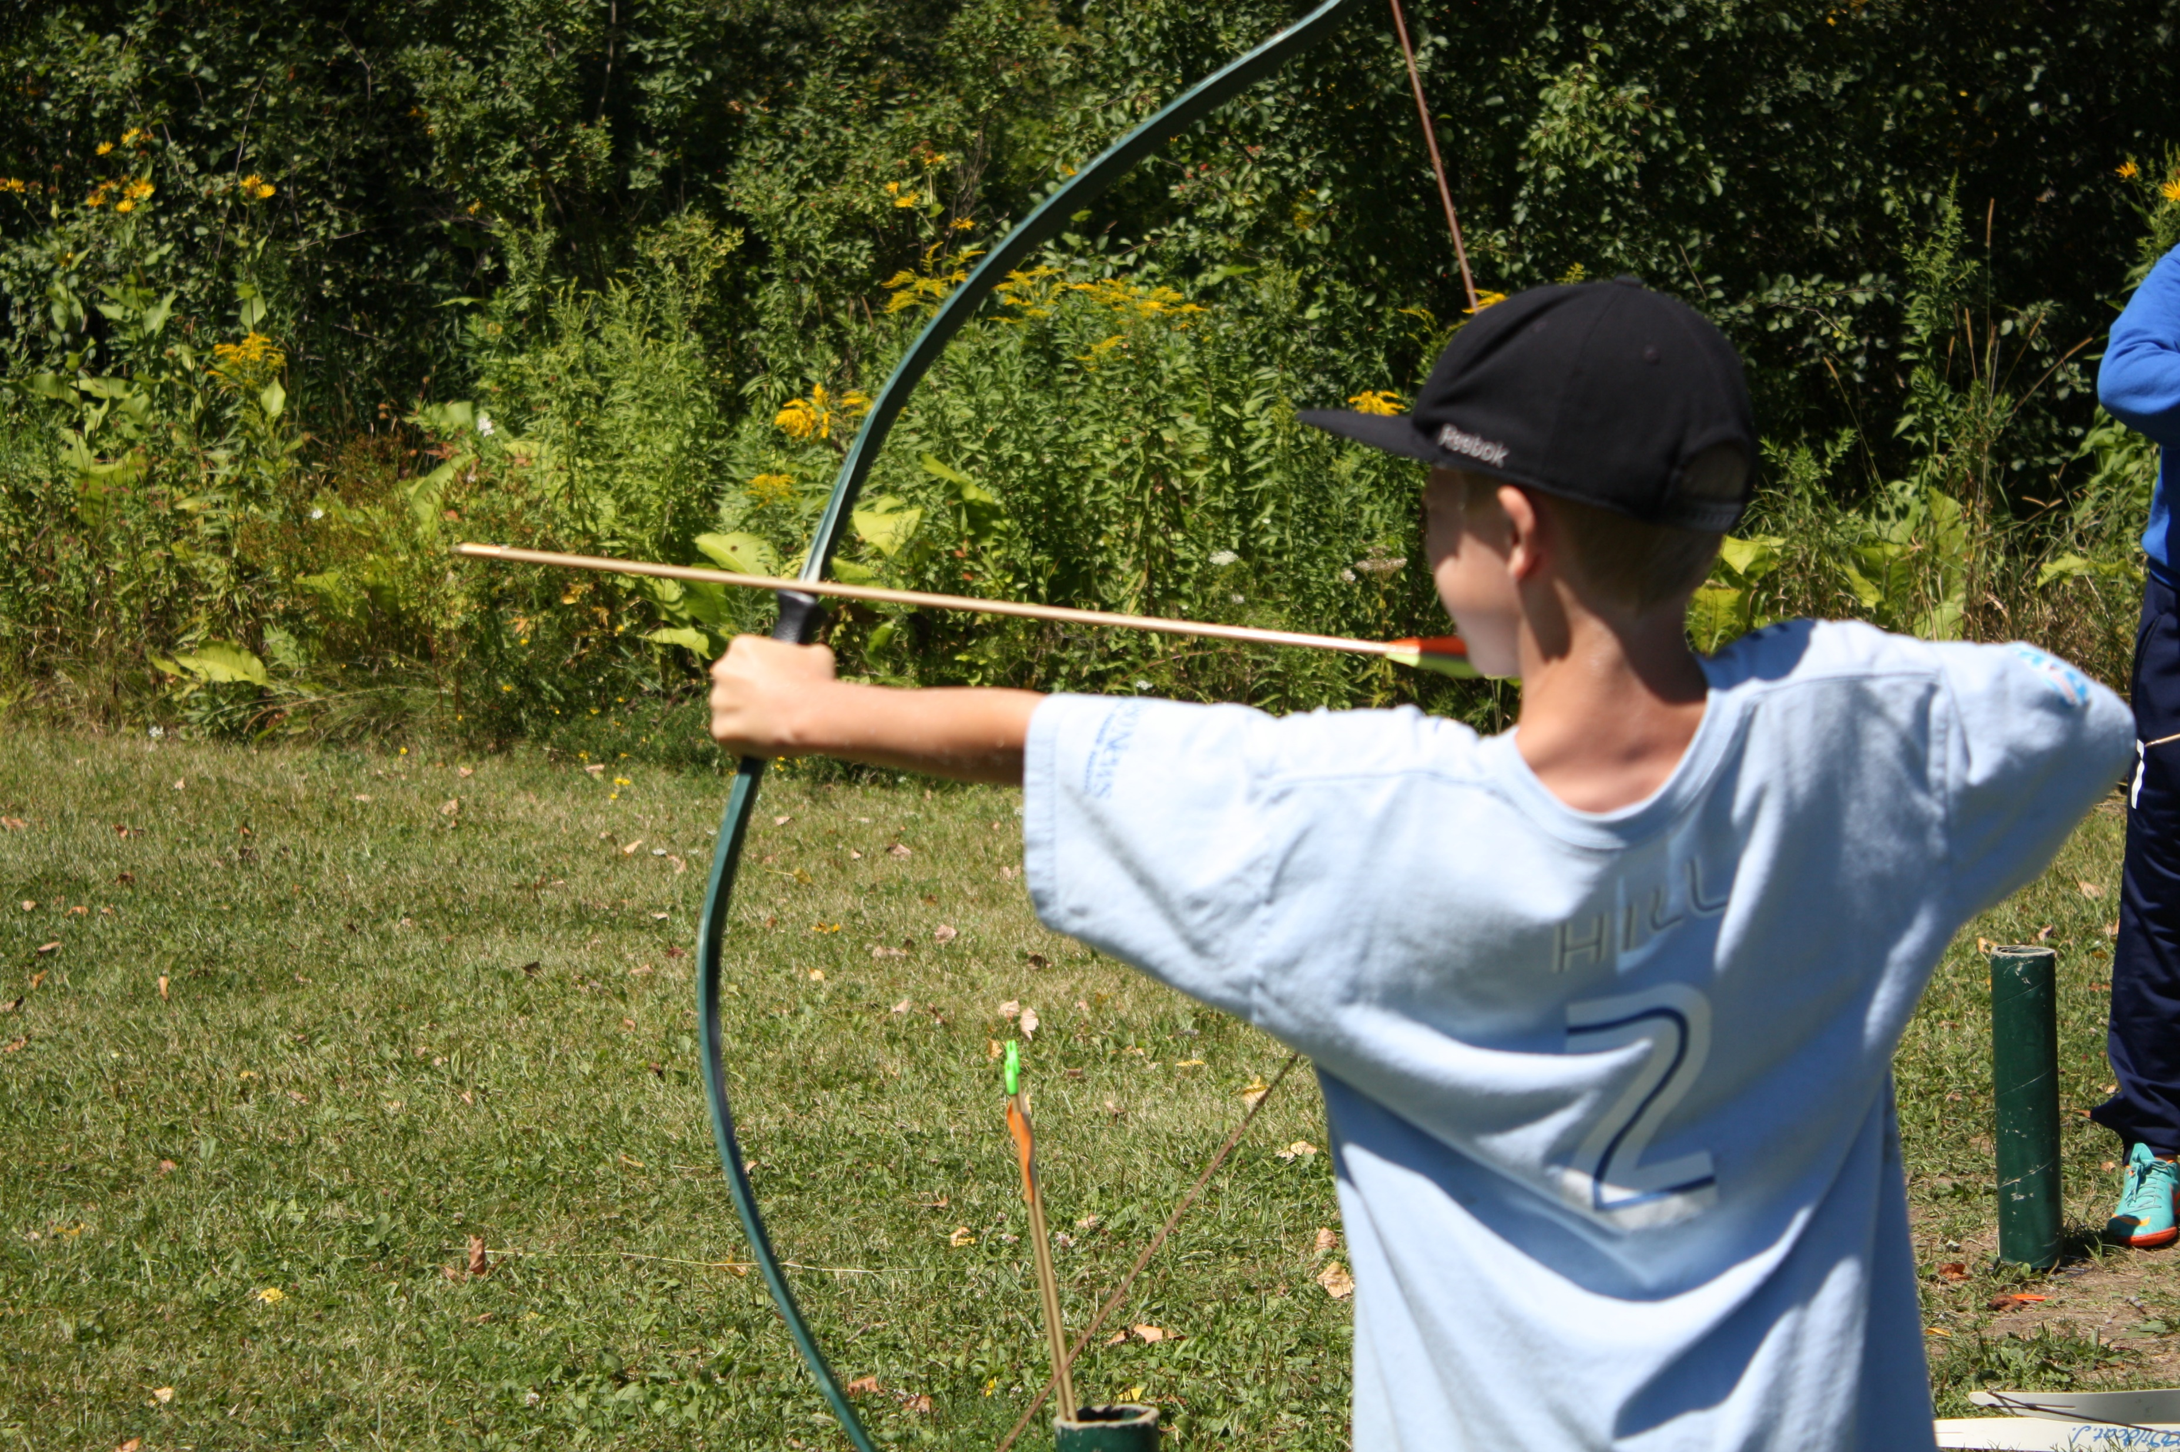
2024 Annual Progress Report
Notes:
Now that we have reviewed the framework for evaluating our strategic progress, let’s delve into some of King’s 2024 strategic results.
Just another reminder that the 2024 progress report reflects the actions and progress made in the 2024 year only. Therefore, It is important to note that this presentation is will not convey any actions completed in 2025, as that progress will be included in the year 3 report.
*CLICK

Slide 11
Strategic Performance Report Summary
29 Key Results
Percentage Towards Completion
Actions Undertaken
Status
Notes:
Just a reminder that -
​
Annual Updates are provided in both a percentage form as well as through lists of actions taken.
Data from key result project schedules and monthly internal milestone trackers have helped determine “status” for each key result as well.
*CLICK

Slide 12
Strategic Performance Report Summary
Legend
Key Results Status Summary
A Greener Future
Sustainable Asset Management
3%
28%
14%
72%
Complete Communities
Service Excellence
12%
12%
66%
Notes:
This is a summary of the status of King’s 29 key results in the 2024 reporting year.​
​
The large box represents the overall 2024 key result progress status, and the smaller boxes display the status of the 7-8 Key Results from each priority area.​
​
Overall
4 Key Results (or 14%) of the plans total KRs, have been completed to date.
20 of King’s key results (or 69%) are proceeding as scheduled
4 Key Results (or 14%) are being monitored
1 key result, totalling to 3%, is not scheduled to start until 2026
*CLICK

Slide 13
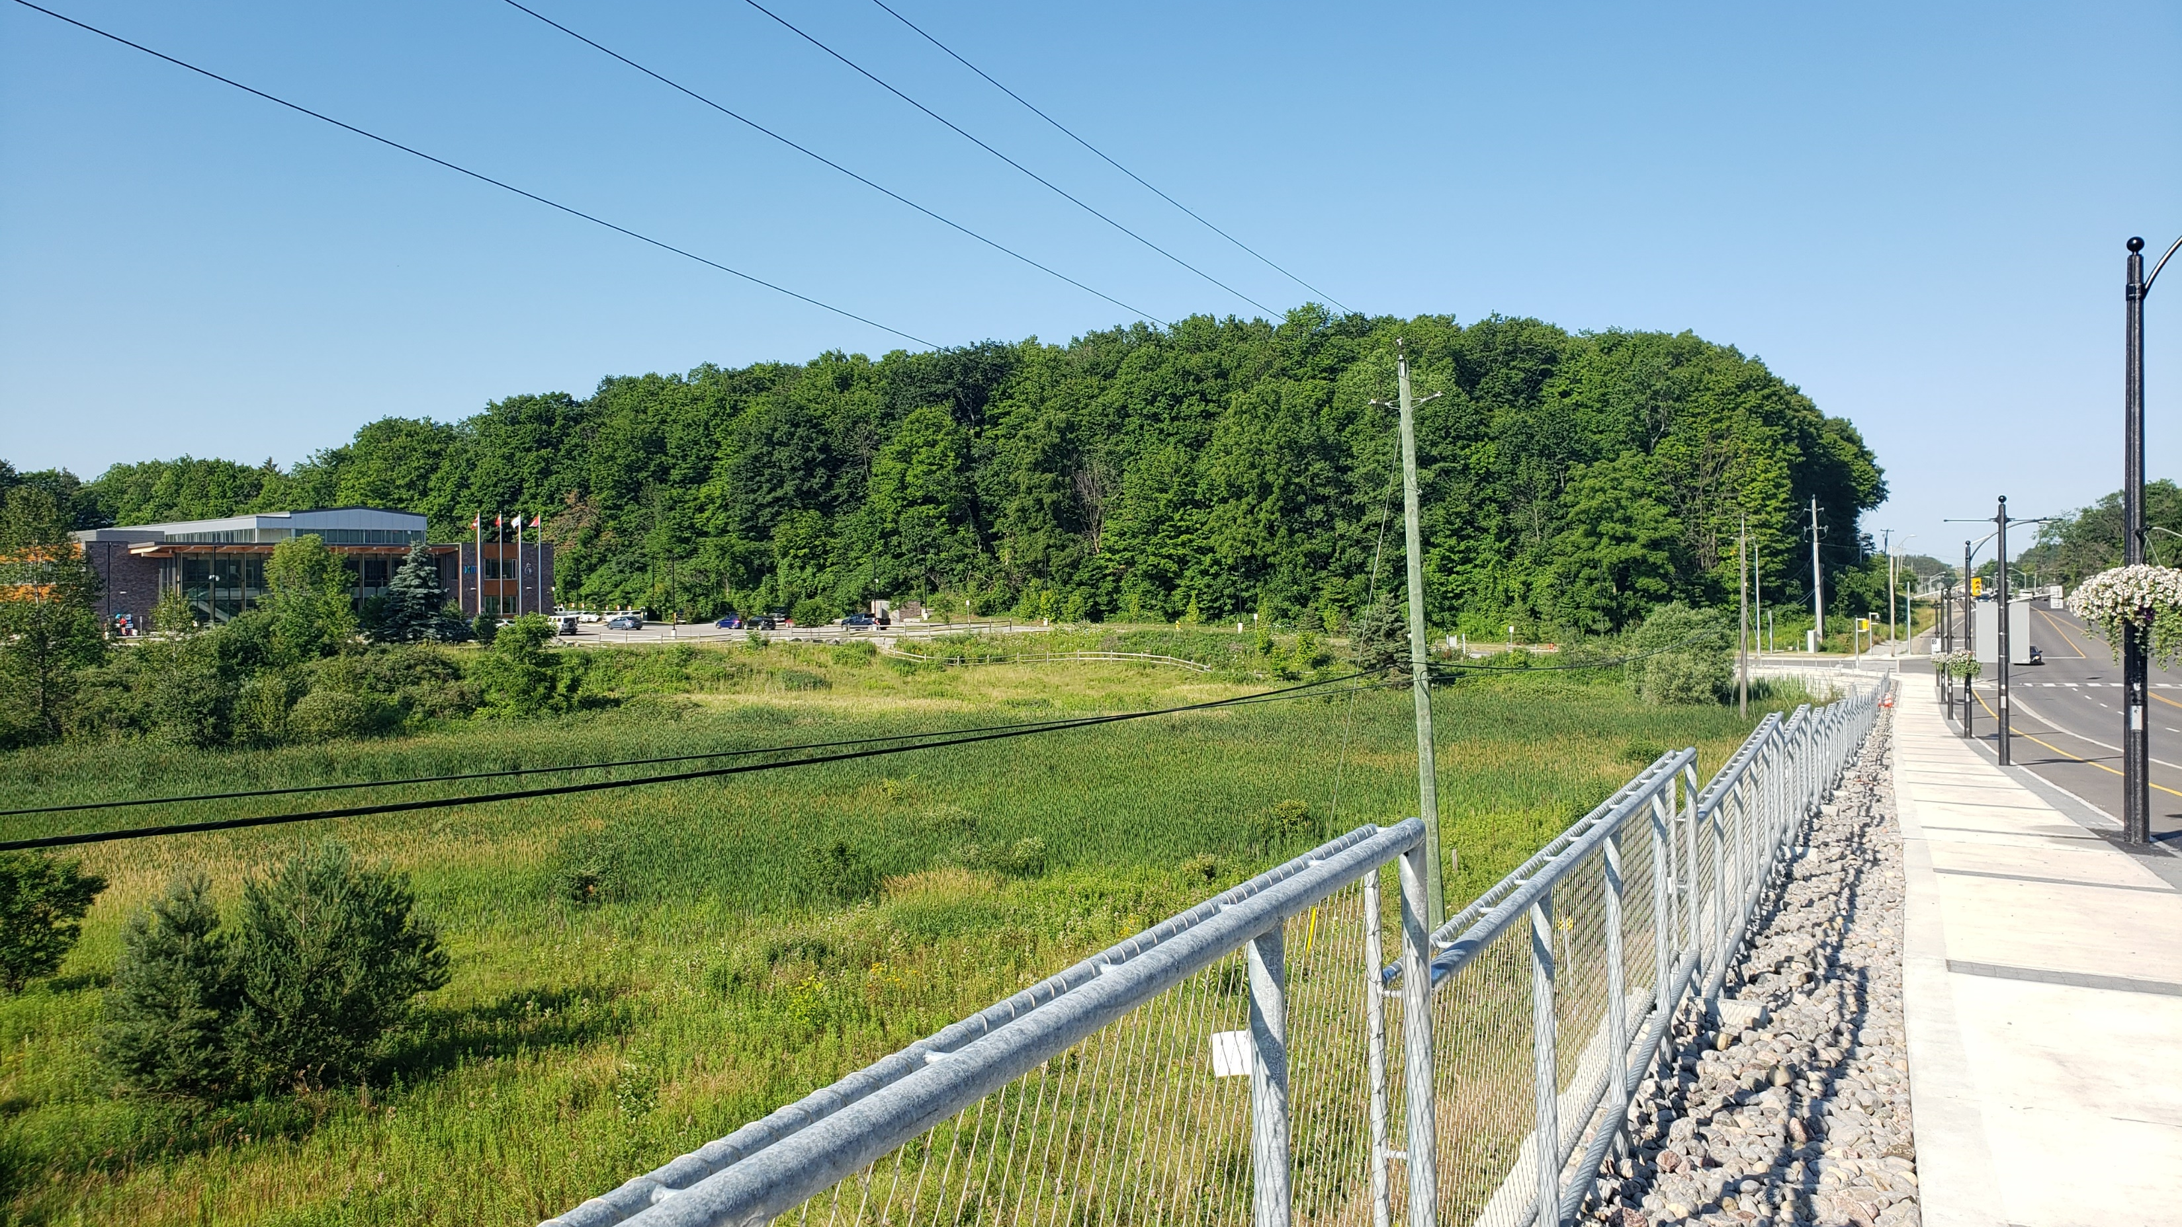
Highlights by Priority Area
Notes:
Now that we have had a chance to see the overall status summaries, I will now highlight some strategic actions undertaken in the 2024 reporting year across each of the 4 priority areas.
*CLICK

Slide 14
A GREENER FUTURE
Notes:
The first priority area we are reporting on is “A Greener Future”.​
​
Planning for a green and sustainable future means finding ways to adapt to climate change pressures while also offsetting the effects that it has already had. It means focusing on protecting and enhancing our environment and natural lands, while maintaining future sustainability
*CLICK

Slide 15
Develop environmentally sustainable solutions to reduce King's footprint and mitigate against the impacts of climate change.
Adopt and Begin the Implementation of the Community Climate Change Action Plan 2026.
Reduce Corporate Emissions by 140 Tco2E (tonnes of carbon dioxide).
Develop a Green Development Standards Incentive Program by 2026.
97%
3%
☑ Received Council Endorsement of ThinKING Green Program
☑ Completed a Jurisdictional Scan of Incentives in other Local Municipalities
☑ Scheduled Consultations with External Stakeholders in the Development world
☑ Finalized the Draft Action Plan and Presented it to Council for Approval
☑ Published the Plan to King.ca
☑ Began first steps of implementing the Plan’s Short-Term Actions
☑ Update of Corporate Emissions Energy Management and Conservation Plan (CEMCP)
☑ Brought Draft Update to Senior Leadership Team for comment & feedback
PROCEEDING AS PLANNED
BEING MONITORED
PROCEEDING AS PLANNED
Notes:
The first objective in this priority area is to “Develop environmentally friendly solutions to reduce King’s footprint and mitigate against the impacts of climate change”. ​
​
Some noteworthy highlights from 2024 that helped us get closer to this objective include:​
​
Finalizing the Climate Action Plan and obtaining councils approval in September of 2024, ensuring that the plan incorporates public feedback gained through various public engagement methods, so that the Plan is truly reflective of community needs and desires before beginning implementation of the plans short-term actions.
*CLICK
We also Completed an update for King’s Corporate Energy Management and Conservation Plan (CEMCP) and engaged the Senior Leadership Team in an insightful feedback session to refine and enhance the strategy. The ;pan was posted publicly in 2024 and presented to council in early 2025.
*CLICK
Last, we received Council endorsement for the ThinKING Green program and completed a jurisdictional review of incentive opportunities in other local municipalities and. We even held consultations with stakeholders in the development industry to gather valuable insights and expertise to help shape the Township's Green Standards Incentive Program.
The progress made in 2024 for this objective is a ​result of internal efforts and programs to walk the talk as an organization when it comes to our role in climate change
​
It is important to note that the Key Result “Reduce Corporate Emissions by 140 tc02e” is only considered “Being Monitored” due to the fact that accurate corporate emissions data at this time remains unavailable for the 2024 reporting year. The Federal government of Canada has yet to publish their emissions factors by the time of the release of this annual progress report and presentation. Using the factors provided by the federal government in our emissions calculations are critical for accurate reporting as they consider things like climate change trends.
Therefore, this Key Result remains at 97% complete (the same as the previous reporting year), until the federal factors are made available and proper emissions calculations can be determined.
*CLICK

Slide 16
Promote Tree Canopy Growth and Enhance Natural Lands
Inventory all Township Natural Assets by 2026.
Develop an Invasive Species Management Strategy by 2026.
Achieve the York Region minimum canopy cover recommendation for King of 36%
☑ Completed a Benchmark analysis of municipal Invasive Species Management Strategies (ISMS)
☑ Obtained a Consultant from the Invasive Species Management Center
☑ Planned external and internal stakeholder consultations
☑ Completed a Benchmark analysis of municipal Natural Asset Inventories
☑ Applied & Secured external Funding from Greenbelt
☑ Completed Natural Asset Current State Analysis
☑ Presented the King Forest Study
☑ Identified new restoration locations for plantings in 2025
☑ Developed a Process for Environmental Impact Reviews on new developments
94%
6%
50%
50%
PROCEEDING AS PLANNED
PROCEEDING AS PLANNED
Plant 50,000 trees, shrubs and wildflowers.
☑ 9,045 plantings in 2024
☑ Developed Community Tree Planting and Maintenance Procedure.
PROCEEDING AS PLANNED
BEING MONITORED
Notes:
The next objective in this priority area is to “Promote Tree Canopy Growth and Enhance Natural Lands”.​
​
Some ways that the Township has been taking action to achieve this objective in the 2024 reporting year is through:
​
Completing a Benchmark Analysis of Natural Asset Inventories (NAI) and Invasive Species Management Strategies (ISMS) from other local municipalities, leveraging best practices to inform King’s approach while also identifying funding opportunities.
*CLICK
We Planted over 9,000 trees, shrubs and potted wildflowers, in addition to planting 6400sq feet of wildflower seeds while proactively identifying 2025 priority planting locations, quantities and dates.
We Conducted community outreach and education sessions to encourage stakeholders to plant trees and pollinator gardens, as well as began to develop an internal Community Tree Planting and Maintenance Procedure, to encourage proper care and maintenance, helping trees thrive and grow into lasting contributions to the environment.
*CLICK
Last, Collaborated with the Toronto Region Conservation Authority to finalize and presented the King Forest Study to Senior Leadership, as well as identified new restoration locations in 2025.
It is also important to note here that The Key Result “Plant 50,000 trees, shrubs, and wildflowers” is considered “Being Monitored” as a total of 15,843 trees have been planted to date, which is below forecasted mid-term target of 25,000. However, plans for the second half of the term are expected to compensate for variances from the first half of the term, including a substantial planting at the Zancor Centre planned for this Spring.
*CLICK

Slide 17
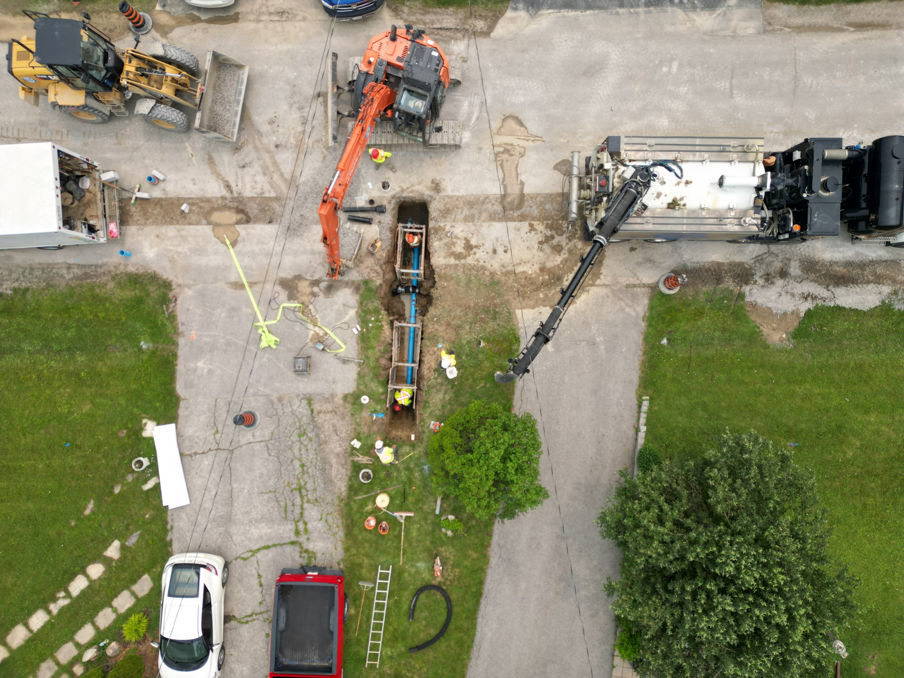
SUSTAINABLE ASSET MANAGEMENT
Notes:
The next priority area for reporting is sustainable asset management.​
​
Planning for investments in the Township’s infrastructure, ranging from transportation assets and environmental assets to facilities and parks, will allow the municipality to maintain its existing infrastructure while planning for new growth and development.
*CLICK

Slide 18
Develop asset funding strategies which ensure long term fiscal sustainability.
Implement a Stormwater Charge by 2023
Finalize and Implement the Asset Management Program by 2025.
☑ Stormwater Charge Implemented and Key Result completed in 2023 reporting year
☑ Updated the Corporate Asset Management Policy
☑ Completed Phase 1 of the non-core Asset Management Program
☑ Continued our Asset Inventory and Condition Assessments
☑ Began the development of the 10-year expenditure and revenue forecast
COMPLETE
Create and Implement an Asset-Funding strategy by 2025.
☑ Conducted workshops for the Asset Management Program Financial Data Review
☑ Initiated a financial strategy for current, medium, and high Levels of Service
☑ Initiated the Development Charges Study
70%
30%
PROCEEDING AS PLANNED
PROCEEDING AS PLANNED
Notes:
In this priority area, the first objective is to “Develop asset funding strategies which ensure long term fiscal stability”,​
​
Some actions that helped drive this objective forward is:​
​that we Updated the Corporate Asset Management Policy, continued King’s Asset Inventory, Condition Assessments and the Level of Service 10-year Forecast, including expenditures and revenues, to help develop a fully funded comprehensive Asset Management Program and Asset Management Funding Strategy, both intended to come to Council in summer of 2025.
We also Finalized the lifecycle management strategy, expanding on the existing 2021 Asset Management Plan for core assets, getting us closer to establishing levels of service for ALL of our capital assets
*CLICK

Slide 19
Improve our capital assets (transportation, environmental, facilities and parks) for continued community use and enjoyment.
Develop and Implement a Stormwater Monitoring and Maintenance Strategy by 2026.
Update (5) asset-related Master Plans & Strategies by 2025.
☑ Completed the stormwater asset draft inspection, maintenance, and prioritization internal report
☑ Completed staff training on stormwater infrastructure.
☑ Completed stormwater modelling
☑ Initiated the first draft of the Operations and Maintenance Manual
PROCEEDING AS PLANNED
☑ Held Internal Technical Advisory Meetings and/or offered multiple public engagement opportunities for the development of the:
Transportation Master Plan (TMP)
Active Transportation Strategy (ATS)
Water/Wastewater Master Plan (WWWMP)
Parks & Trails Master Plan
Facilities Master Plan
Establish the levels of service for all capital assets by 2025.
Develop an Asset Disposition Strategy by 2025.
☑ Finalized the Lifecycle Management Strategy
☑ Initiated a Draft Inventory of Lands in King
PROCEEDING AS PLANNED
BEING MONITORED
PROCEEDING AS PLANNED
Notes:
The next objective in this priority area is to “improve our capital assets for continued community use and enjoyment.​
​
Some actions that were undertaken in the 2024 year were:​
​
Completing staff training on stormwater infrastructure and initiated a draft of the Operations and Maintenance Manual for the Township, which is expected to be presented to Council in Q4 of 2025.
*CLICK
Held internal Technical Advisory Committee meetings to gain cross-functional inputs from relevant divisions for the Parks & Trails Masterplan, the Facilities Master Plan, the Water/Wastewater Master Plan, the Transportation Master Plan & the Active Transportation Strategy.
We also Offered multiple opportunities for public engagement and input into these plans, such as using SpeaKING pages, releasing surveys and hosting open houses, which allowed King to gather public opinion and feedback to help inform the draft plans
*CLICK
Last, we finalized the lifecycle management strategy as well as Initiated a Draft Inventory of Lands in King.
Consequently, we also began development of a GIS layer map of all available properties to inform the development of the Asset Disposition Strategy andwe successfully disposed of the Nobleton junior school, valued at 5.8m.
It is important to note that the Key Result “Develop an Asset Disposition Strategy by 2025” is “being monitored” and only 25% complete due to delays in several processes including Neighbourhood Block Plan exercises, which impacted the critical path for this Key Result, as well as due to conflicting information over municipal parcel assets. Though, the project team has now identified accurate information on all available properties and the Key Result is being evaluated to determine if its target requires any adjustment.

Slide 20
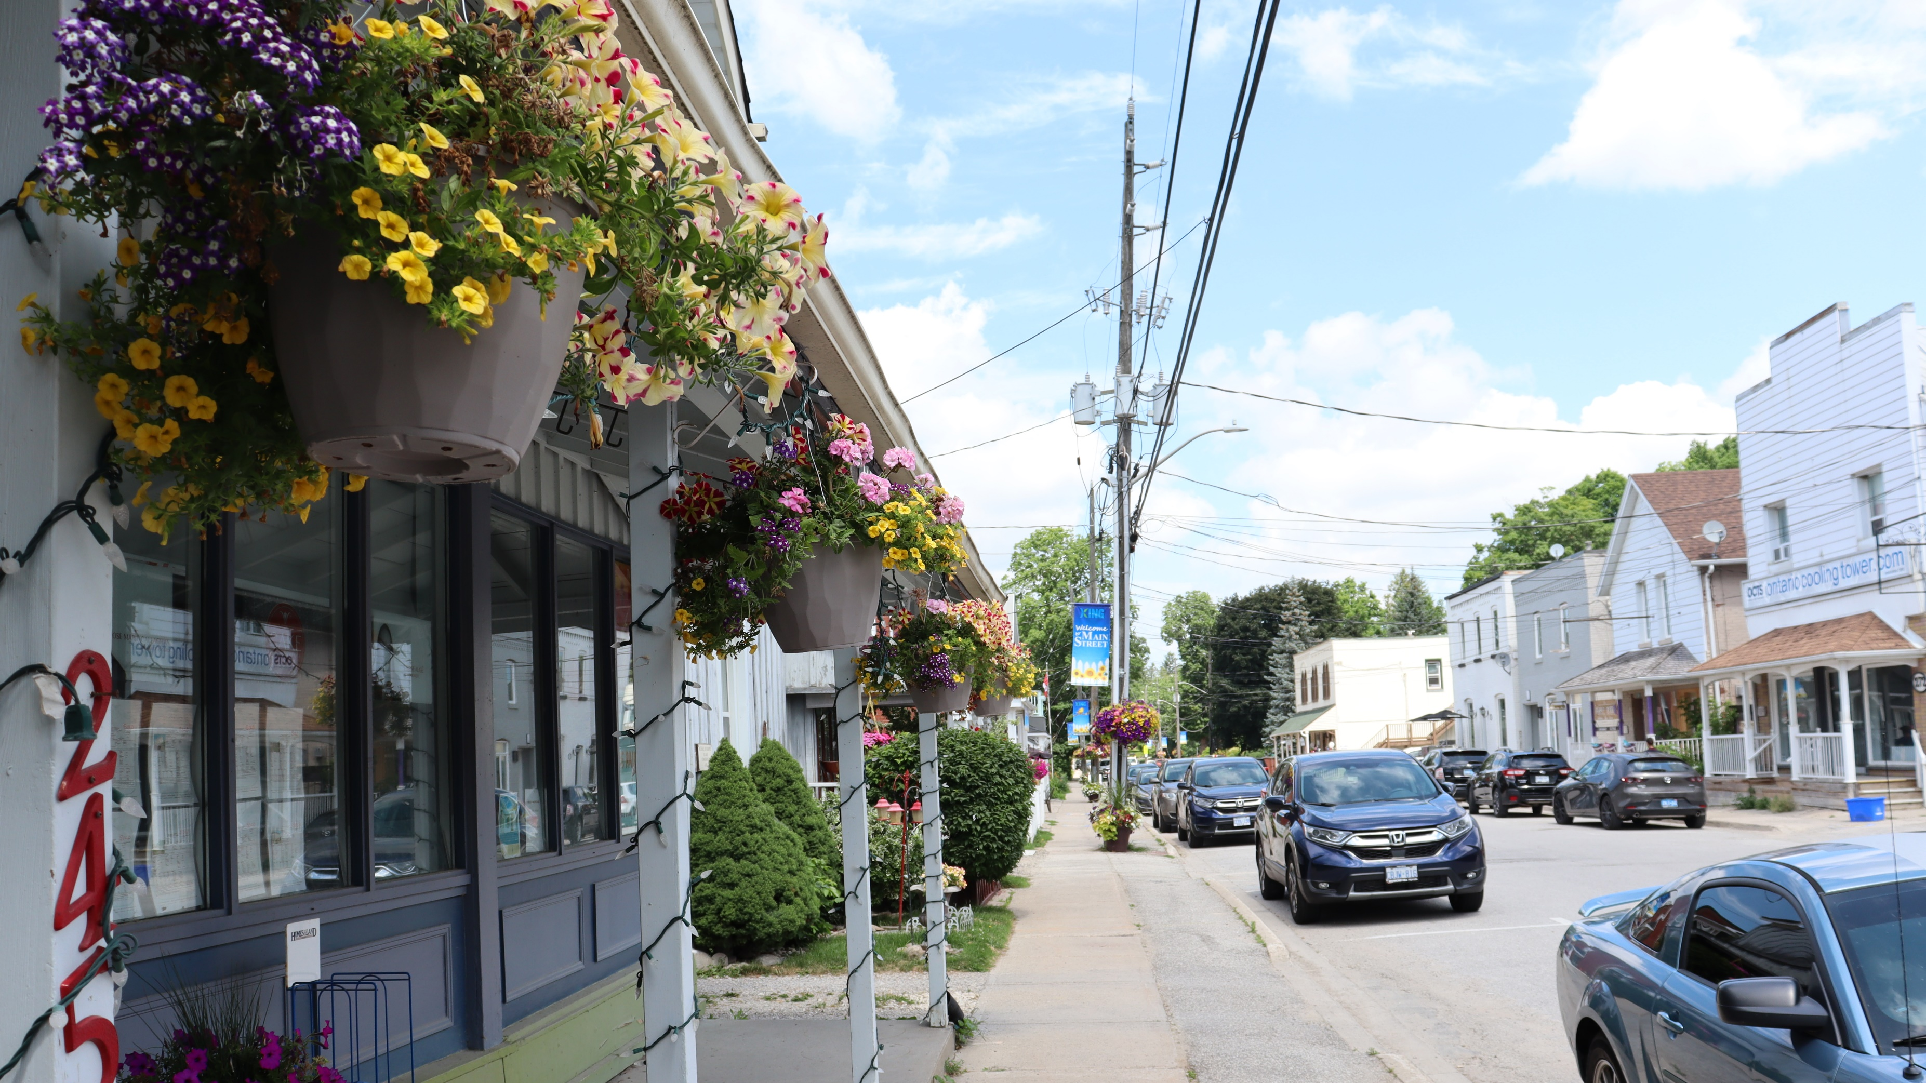
COMPLETE COMMUNITIES
Notes:
Next are the highlights from the priority area “complete communities”.​
​
Strengthening the capacity of the Township and its citizens will enable continued collaboration to resolve challenges and maximize opportunities to build stronger, safer communities.
*CLICK

Slide 21
Implement regulatory changes to manage growth which best serves King’s unique landscape.
Complete the Official Plan review and update (to 2051) by 2025.
Update Urban Zoning By-law within 1 year of the OP update.
Explore opportunities for Commercial Licensing and if approved, implement programs by 2026.
SCHEDULED TO START IN 2026
☑ Advanced the Growth Management and Employment Lands Strategies
☑ Held multiple types of Public Engagement Opportunities
☑ Held Council Education Sessions
NOT STARTED
☑ Reviewed Current Business License Model
☑ Conducted a Business Licensing Inventory
☑ Procured Consulting Services to develop options for licensing framework
Conduct the Blue Box Transition by 2025.
☑ Determined non-eligible site locations
☑ Created other recycling options for ineligible sites
☑ Obtained pricing for alternative options
PROCEEDING AS PLANNED
PROCEEDING AS PLANNED
PROCEEDING AS PLANNED
Notes:
The first objective in this priority is to “Implement regulatory changes to manage growth which best serves kings unique landscape”.​
​
Some actions that have taken place include:​
​
​Holding multiple public engagement opportunities, such as virtual and in-person public open houses, as well as conducting stakeholder interviews to gain public input for the development of the Official Plan update as well as the Growth Management and Employment Lands Strategies.
*CLICK
We Continued to conduct the blue box transition by determining which sites were not eligible for the transition and consequently establishinf a recycling option for these ineligible sites so that they can continue receiving recycling services post-transition, which are fully cost recoverable.
*CLICK
Last, we Reviewed and assessed current business license models and tools in King and also developed options for a commercial licensing framework in partnership with experienced consultants, leveraging their expertise.
*CLICK

Slide 22
Enrich community well-being and make King the ideal place to live, work and play.
Develop and implement a streamlined program that consolidates all existing municipal funding, grant programs, donations, and in-kind contribution requests by 2024.
Develop an Action Plan and begin implementation to become an “Age-Friendly Community” by 2026.
Represent King’s interest in major external developments within the Township.
☑ Monitored and advocated for King in the development of:
Highway 413
Bradford by-pass
Go-Train (2) way service
☑ Collaborated with the Ministry of Agriculture, Farming and Rural Affairs to identify farming opportunities
☑ Implemented a new concierge service for business moving to King
☑ Created the AFC Steering Committee
☑ Launched the New Program Intake Streams and Eligibility Criteria
☑ Launched new funding and grant programs
☑ Launched the In-Kind request component of the EnrichKING portal
BEING MONITORED
Develop and implement an annual Traffic-Safety campaign that runs for (1) month annually.
☑ Created the “Safe Streets Campaign” and Launched the Campaign for 4 weeks
☑ Collaborated with York Region Police
☑ Began plan for 2025 annual campaign
COMPLETE
PROCEEDING AS PLANNED
PROCEEDING AS PLANNED
Notes:
The second objective in this priority area is to “enrich community well-being and make King the ideal place to live, work and play”.​
​
Some noteworthy highlights include:​
Launched the NEW Program Intake Streams & Eligibility Criteria, a NEW funding and grant program, and we also launched the NEW In-Kind request component to the Enrich King Portal, streamlining all funding, grants, donations and contribution requests through the EnrichKING program.
*CLICK
We also Established the Age Friendly Community (AFC) steering committee and initiated community engagement, gaining insights and making steps towards the development of the Age Friendly Community Plan.
*CLICK
We Represented King’s interests in major external developments by continuing to monitor the development of highway 413, advocating for the Townships needs throughout, by maintaining touchpoints with Ministry of Transportation Staff and also by collaborating with the Ministry of Agriculture, Farming and Rural affairs to help identify opportunities for farming in King, among many other active efforts.
*CLICK
Last, Created and Launched the Safe Streets Campaign, which ran for 4 consecutive weeks and included collaboration with York Regional Police to host school events and educate students on and promote traffic safety in King.
It is important to note that The Key Result “Develop an Action Plan and begin implementation to become an ‘Age-Friendly Community’ by 2026” is “being monitored” as the project schedule is slightly behind its forecasted plan for the 2024 year, due to consultant delays experienced with the completion of a background report to initiate the Township needs assessment, which is an essential first step in becoming an AFC.
*CLICK

Slide 23
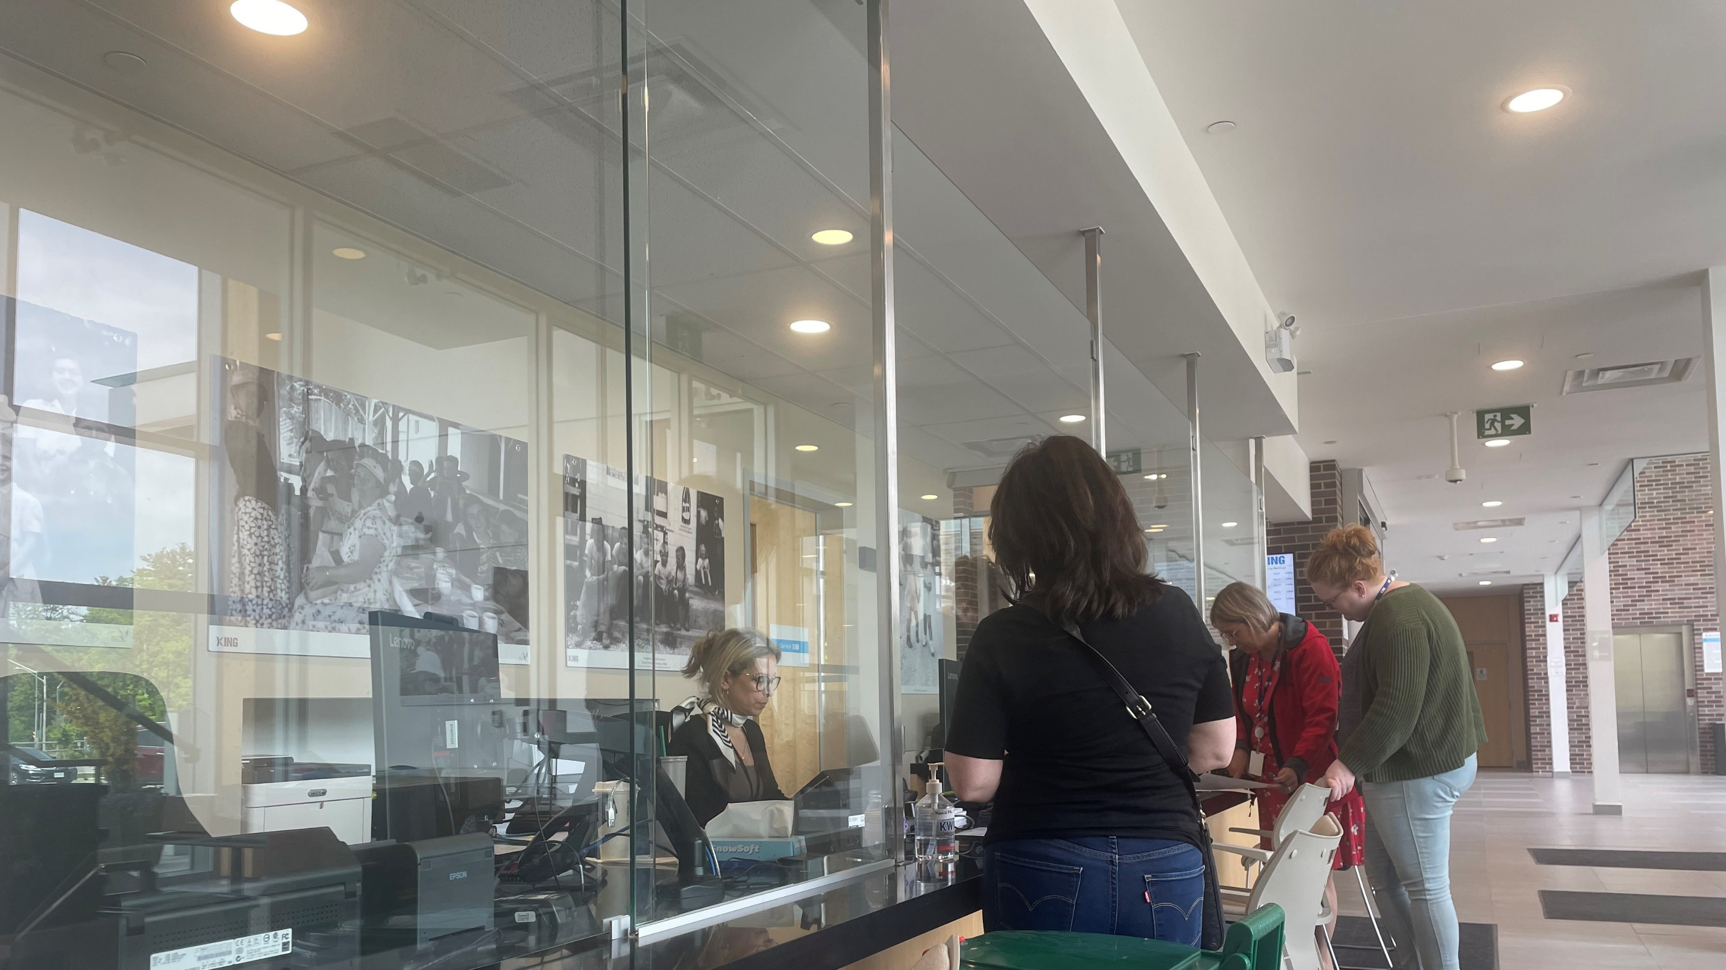
SERVICE EXCELLENCE
Notes:
Last, we have our final priority area, which is service excellence.​
​
Exploring and implementing innovative methods for communicating with the community and delivering services through technology and modernization will allow the Township to work towards exceeding service expectations and surpassing customer service standards to meet the needs of citizens.
*CLICK

Slide 24
Increase data-driven decision making to improve organizational performance
Develop and evolve a Corporate Performance Accountability Program by 2026
Develop a Digital Transformation Framework and implement Phase 1 by 2025.
☑ Developed and launched the Digital Transformation Framework and drafted the Responsible AI Roadmap
☑ Launched Co-pilot for staff use internally & for public use externally with “Kingsley” at king.ca
☑ Created dynamic appointment booking for marriage licensing and commissioner of Oaths
☑ Completed (5) draft Policies and procedures for responsible AI use: the Privacy Policy, Data Steward List, Data Cleansing Procedure, Data Forms Procedure & Data Governance Policy
☑ Presented the 2023 Operational Service Performance Report in Q2 2024
☑ Launched Divisional Service Profiles
☑ Presented the 2023 CSP Annual Progress Report in Q2 2024
☑ Rolled out monthly Internal CSP Status and Milestone Updates
☑ Began Draft 1 of the Corporate Accountability Program Policy & Procedure
PROCEEDING AS PLANNED
Publish (4) new open-data sets
50%
50%
☑ Published open data-sets to King.ca:
Planning Applications
Building Permits
Fire Response
Bylaw Inspections
PROCEEDING AS PLANNED
COMPLETE
Notes:
The first objective in this priority is to “increase data-driven decision making to improve organizational performance”​
​
Some actions that have helped move King closer to achieving this:​
​
Beginning to draft the Performance Accountability Program policy and procedure as well as establishing monthly internal reporting requirements for tracking Corporate Strategic Plan progress, reinforcing Kings commitment to providing a high level of transparency that is unique among Ontario municipalities.
*CLICK
We Developed and launched the Digital Transformation Framework, published over 10 internal dashboards, and completed the first drafts of the Data Governance Policy, the Data Privacy Policy, the Data Cleansing Procedure and the Data Forms procedure, providing a solid foundation for the responsible use of AI at King.
Launched the online virtual assistant “Kingsley” on King.ca, offering round-the-clock accessibility, ease of use, and faster solutions to enhance staff productivity as well as citizen satisfaction.
*CLICK
Last, we Published (4) open data sets on King.ca for: planning applications, building permits, fire responses and bylaw inspections, demonstrating our commitment to accountability and transparency to the citizen even further.
*CLICK

Slide 25
Enhance citizen service experience.
Develop and implement a Customer Experience Strategy by 2025
Launch (2) new ServiceKING locations for expanded community use and access.
Reduce “Information Only” Citizen Cases by 30%.
☑ Procured IPSOS as Consultants
☑ Determined Customer Experience Focus Areas
☑ Developed an Internal Stakeholder Interview Schedule
☑ Published ads, posts and reels based on weekly top 5 ServiceKING inquiries
☑ Executed over 50 communications campaigns
☑ Conducted research for the Public Engagement Policy and Communications Policy
☑ Launched Building Self-Serve Appointments
PROCEEDING AS PLANNED
90% of all Township application, requests and forms can be submitted in an automated form.
☑ Developed training and staff manual for ServiceKING
☑ Purchased ServieKING software licenses and trained Trisan and Zancor staff on software.
☑ Initiated a communications plan for the launch of ServiceKing at the Trisan and Zancor centers.
☑ Clerks Marriage Appointments
☑ Commissioner of Oath
☑ EcDev Support Services
☑ Water meter
Installation Requests
COMPLETE
PROCEEDING AS PLANNED
PROCEEDING AS PLANNED
Notes:
Last, our final objective is to enhance the citizen service experience.​
​
Some noteworthy highlights from 2024 include:​
Procuring IPSOS and leveraging their expertise as public opinion specialists to help inform the development of the townships Citizen Experience Strategy, which began with identifying customer experience focus areas and scheduling internal stakeholder interviews.
*CLICK
Advancing the implementation of both Service King Lite sites at the Zancor Center and Trisan Center by successfully installing software, providing Service King training to facility staff and initiated the development of a strategic communications plan for the launch of Service King at both facility locations
*CLICK
We Released three informational videos on the 2024 Service-Based Budget, Whistle Cessation, and Zancor Center opening. We also and Published newspaper ads, social media posts, and Instagram reels based on the weekly Top 5 ServiceKING inquiries.
We also conducted research, a jurisdictional scan and a current state analysis to inform Kings public engagement guideline and communications policy, exhibiting that improving the citizen experience was at the top of mind throughout the 2024 reporting year.
*CLICK
Last, we Transitioned various external facing forms to be fully automated for the public, such as: online commissioner of oath appointments, online marriage appointments, Pre-Authorized Debit Program Enrollment and Cancellation requests, Economic Development Support service requests, and Water meter inspection, installation and repair requests. Automating these forms have allowed us to complete our KR of having 90% or more of our forms automated by the second reporting year!
*CLICK
​

Slide 27
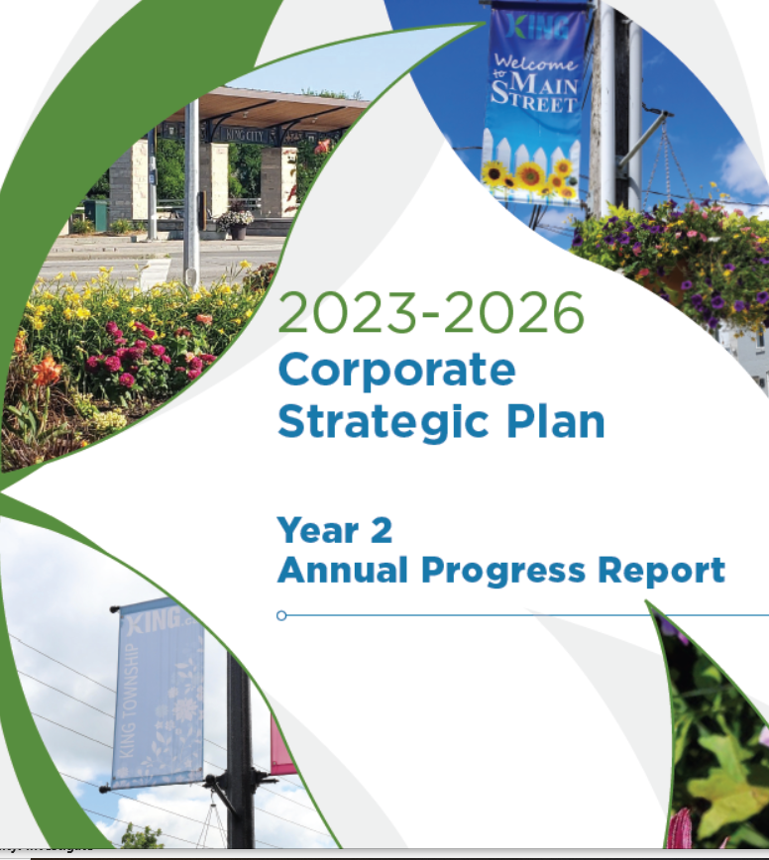
Communications Plan
Newspaper Half Page Ad
Social Media
Media Release
King.ca
Notes:
While our Council, members of the audience and live streamers have had the opportunity to hear about our strategic progress here today, we want to make sure this story gets out to as many people as possible across our community
So, The corporate communications team will be communicating our progress through multiple channels including:
Using infographics to convey CSP progress in In the King Sentinel as well as on the Township social media pages, with an easy QR Code to the Progress Report Booklet and Online Dashboard ​
We will be issuing a media release this week for external promotion and pickup
​Last, we will be posting the online report booklet as well as updating the the CSP Progress dashboard on king.ca/STRATEGICPLAN​
*CLICK

Slide 28
2024 (Year 2) Annual Progress Report Online GIS Dashboard
Notes:
Before we close-out the presentation today, I just wanted to give Council a review of how the dashboard works, which was created by our GIS coordinator.
*CLICK

Slide 29
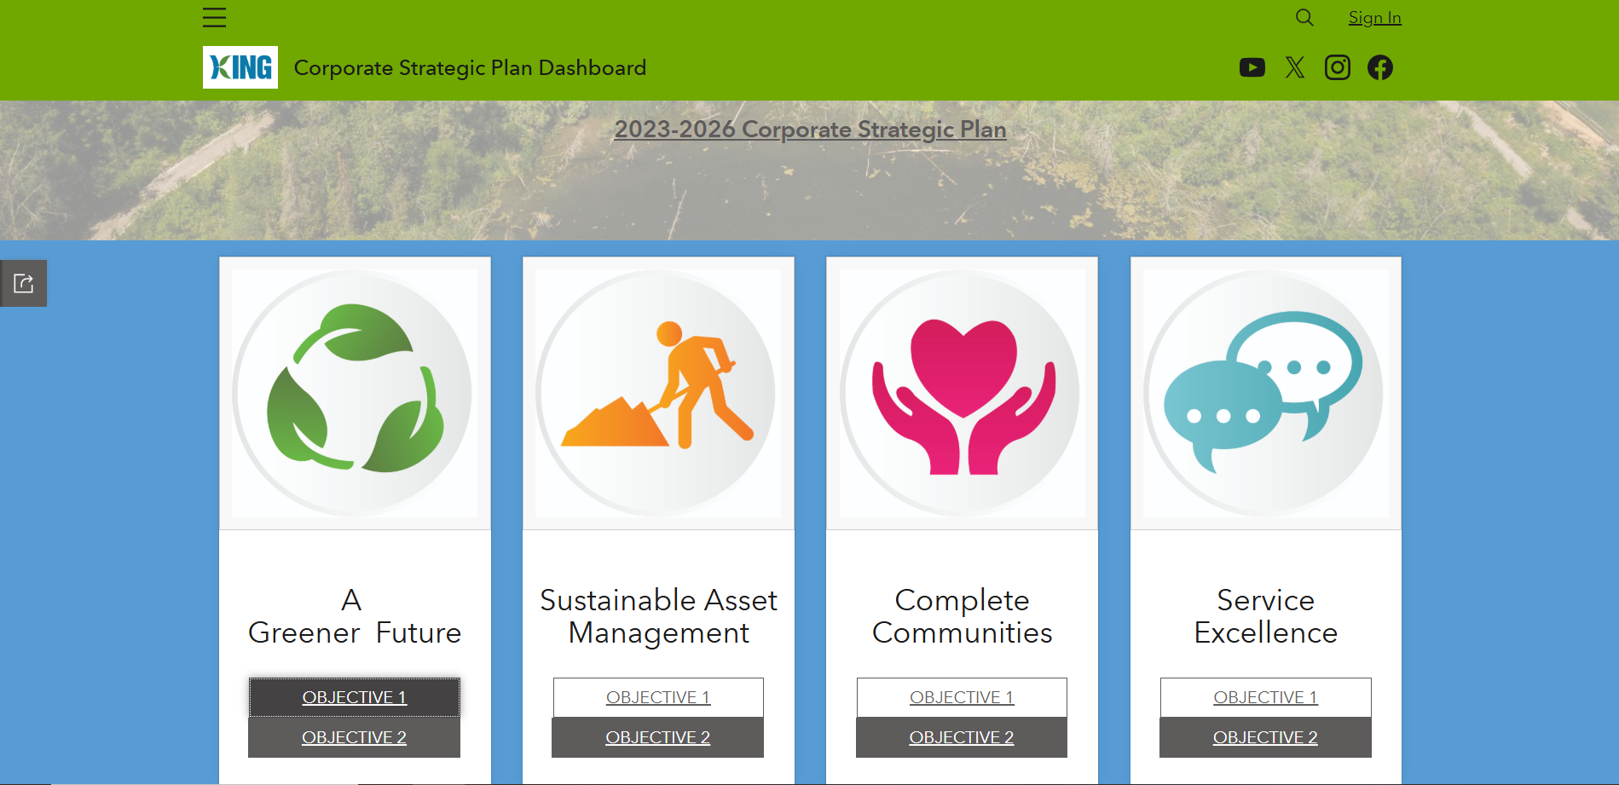
Online GIS Progress Dashboard
Notes:
Once you click the link for the dashboard on king.ca/strategic plan, it will bring you to this landing page. On this page you can chose to delve int any priority area and objective. Lets say we want to click into the first objective for a greener future…
*CLICK

Slide 30
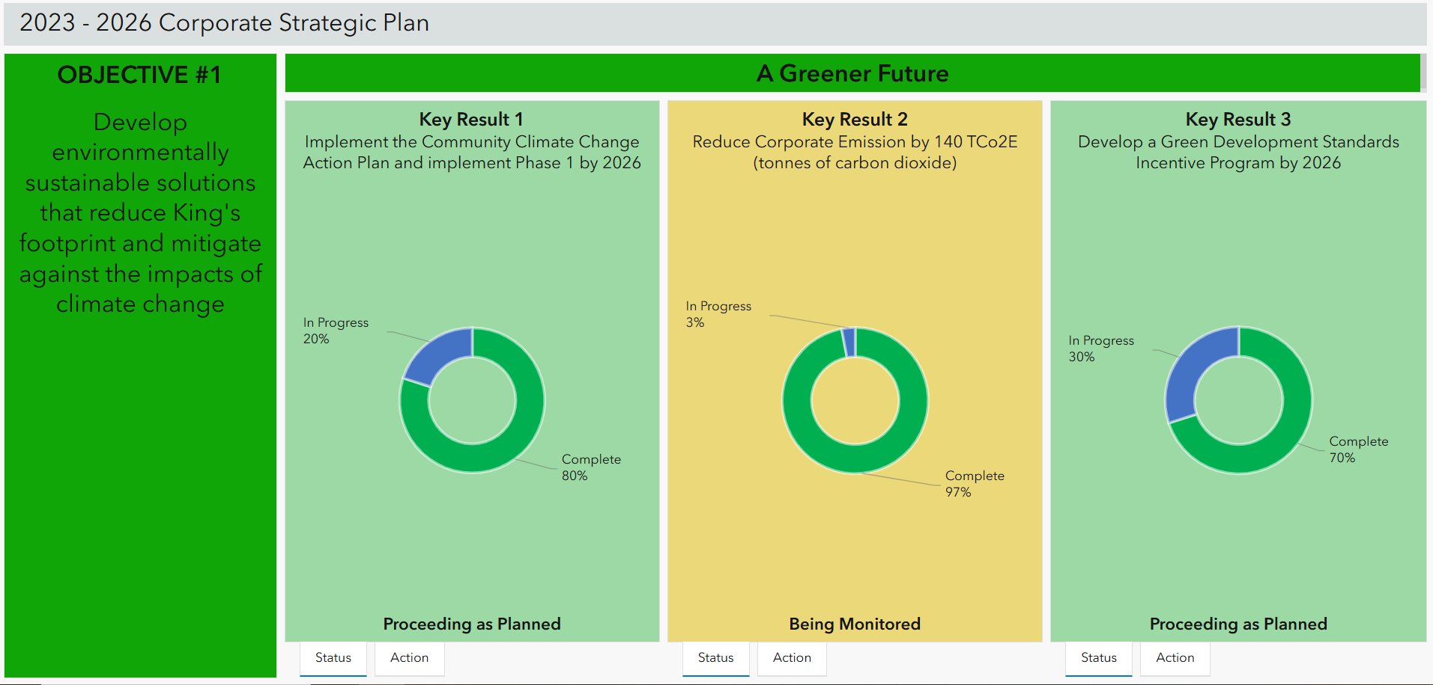
Online GIS Progress Dashboard
Notes:
Once you click into that objective, you are able to see the name of the objective and its accompanying key results, inclusive of their status and percentage of progress complete… and then at the bottom of each key result, there is another tab called “Actions”.
*CLICK

Slide 31
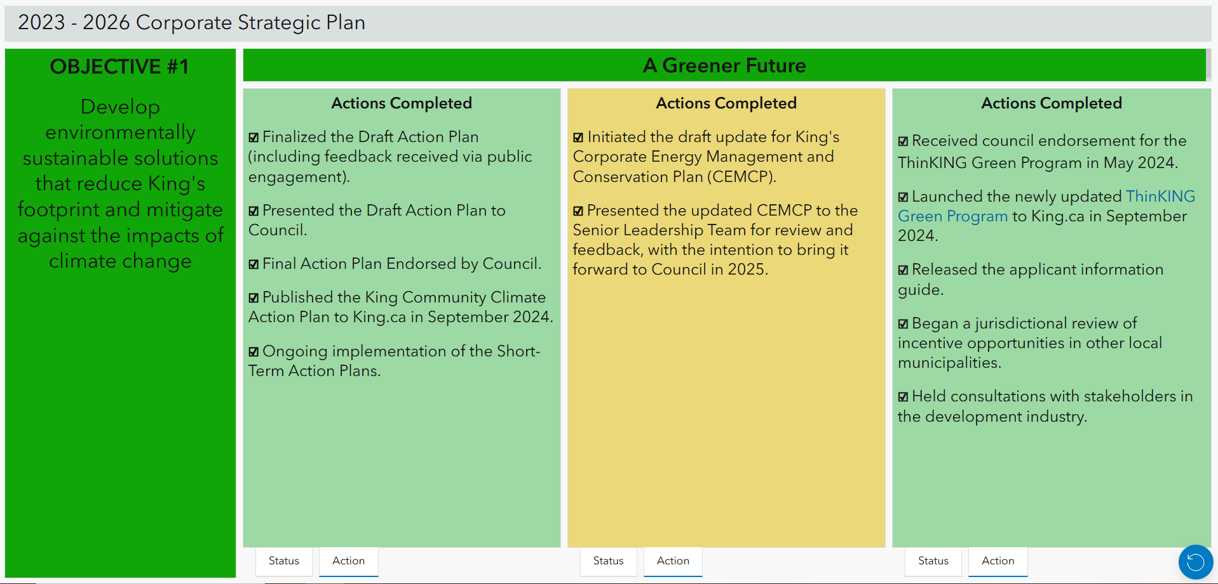
Online GIS Progress Dashboard
Notes:
Once you click on the “action” tab, you are able to see the list of actions that were completed in the 2024 reporting year for each key result.
As you can see on the slide, This dashboard is interactive and easy to consume, as residents can move through it with ease and clarity.
*CLICK

Slide 32
Concluding Remarks
Notes:
To conclude the presentation, overall, King has made significant progress in the second year of its four-year Corporate Strategic Plan that covers this term of Council. As mentioned, more detailed information can be found in the report booklet and online dashboard which can be found at king.ca/strategicplan
​
Thank you for listening and I am happy to answer any questions you may have.
*CLICK

Slide 33
COUNCIL Q&A

